Slide 1
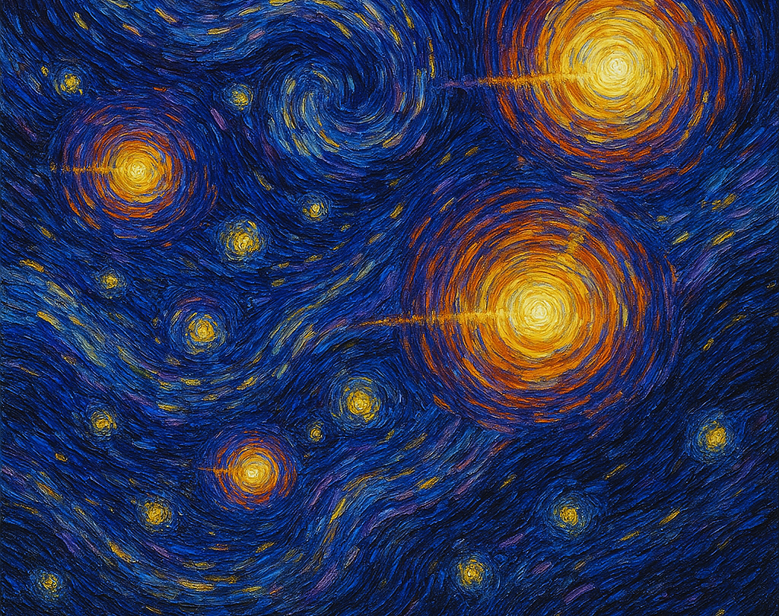
On the Cosmological Time Dilation of High Redshift Quasars
Geraint F. Lewis
The University of Sydney
CosmoVerse @ Istanbul

Slide 2
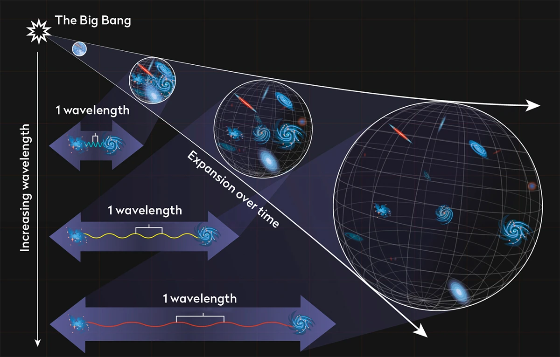
The Expansion of Space
Credit: NASA, ESA, Leah Hustak (STScI)

Slide 3
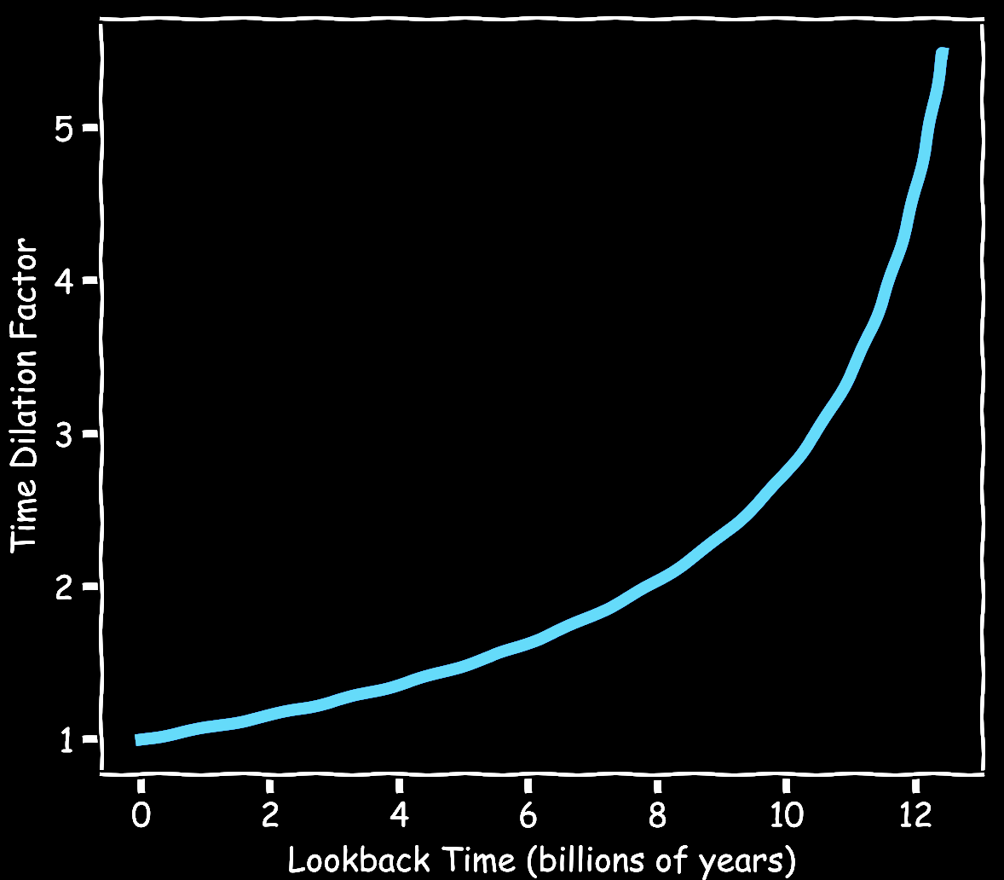
The Expansion of Space: Time Dilation
t ∝ ( 1 + z )

Slide 4
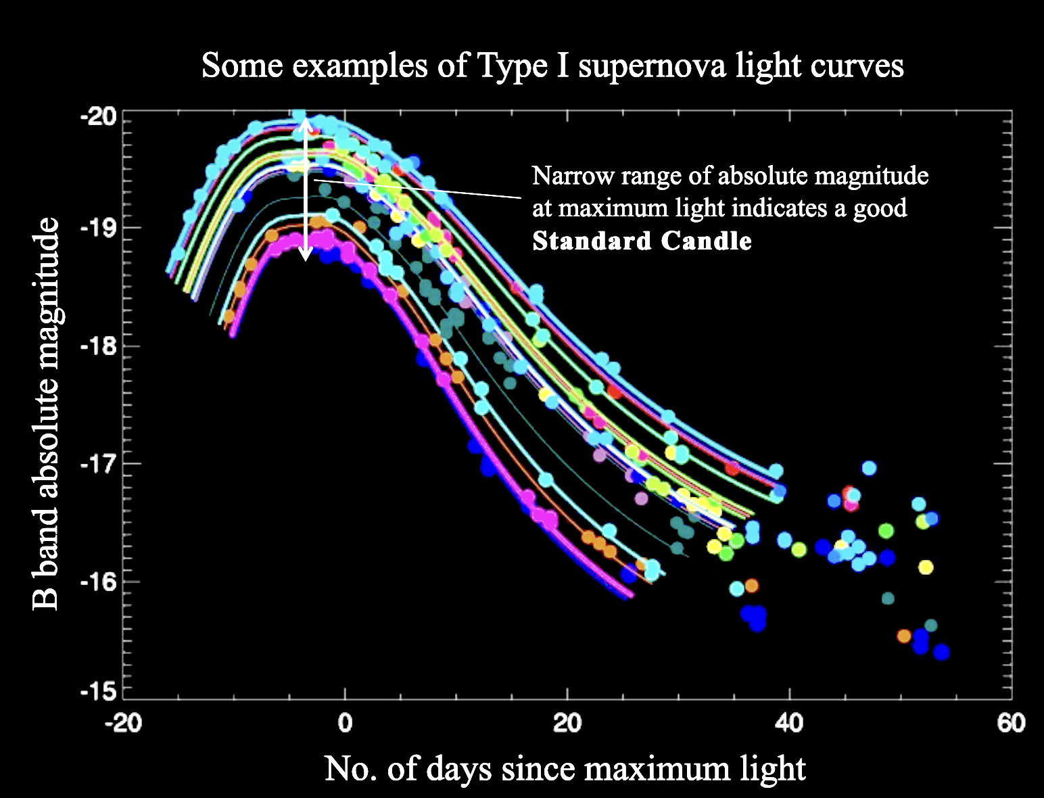
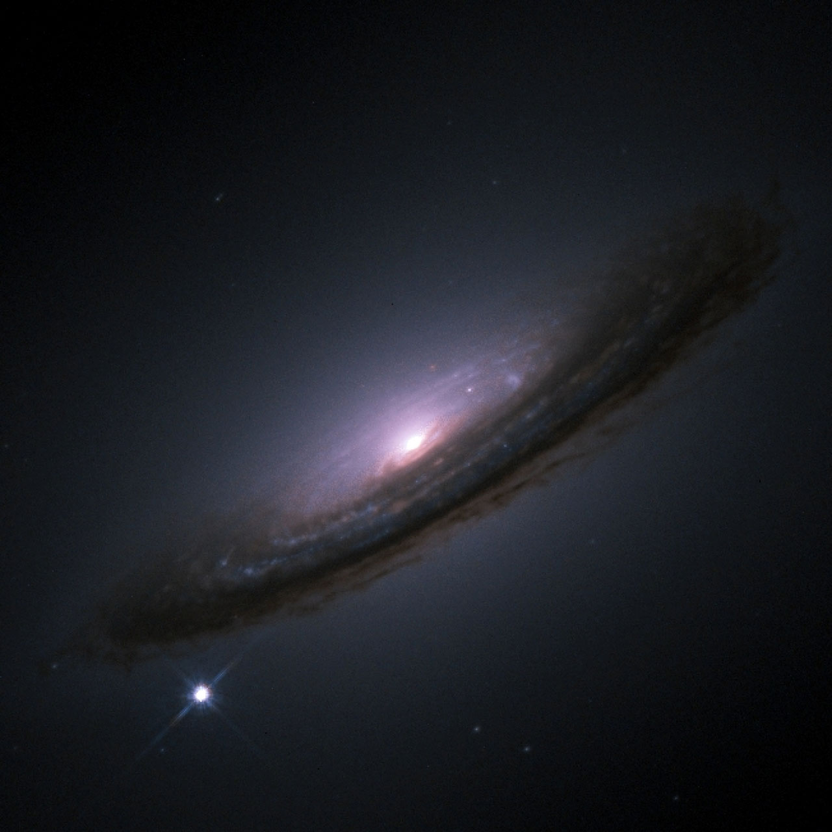
The Expansion of Space: Time Dilation
Cosmological Supernovae
SN 1994D
Supernovae are normalizable!

Slide 5
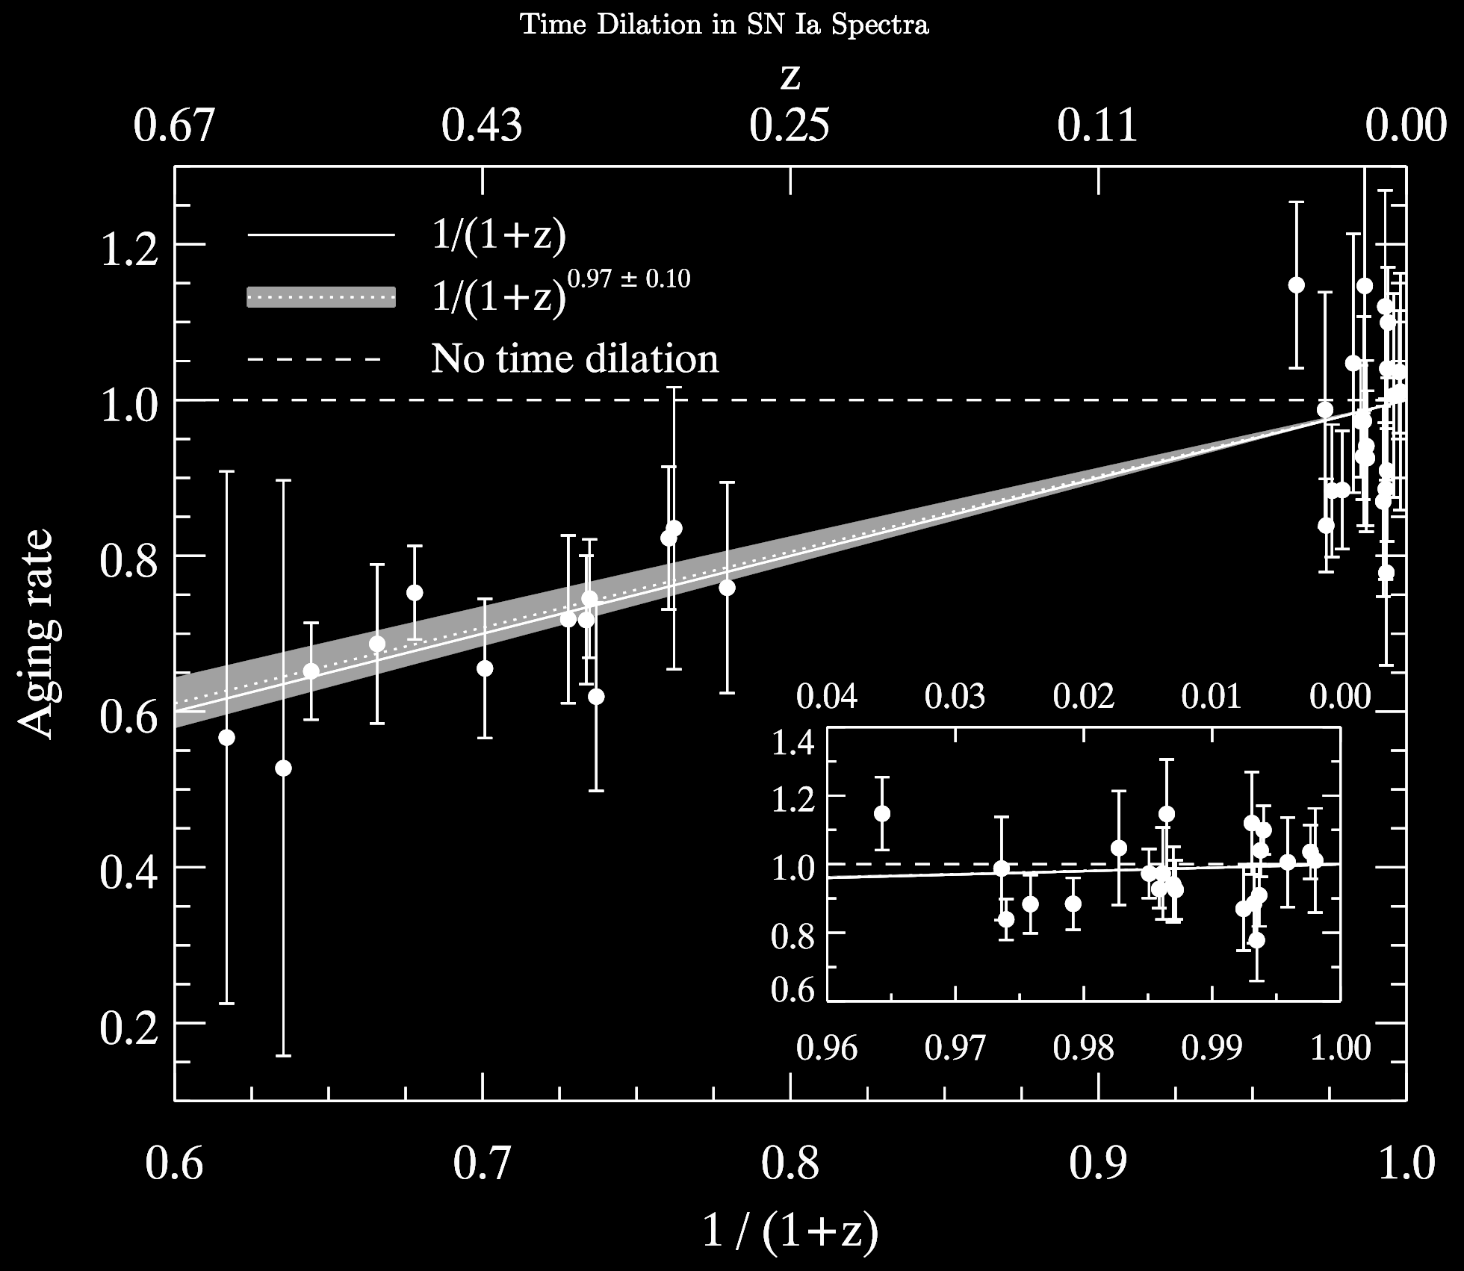
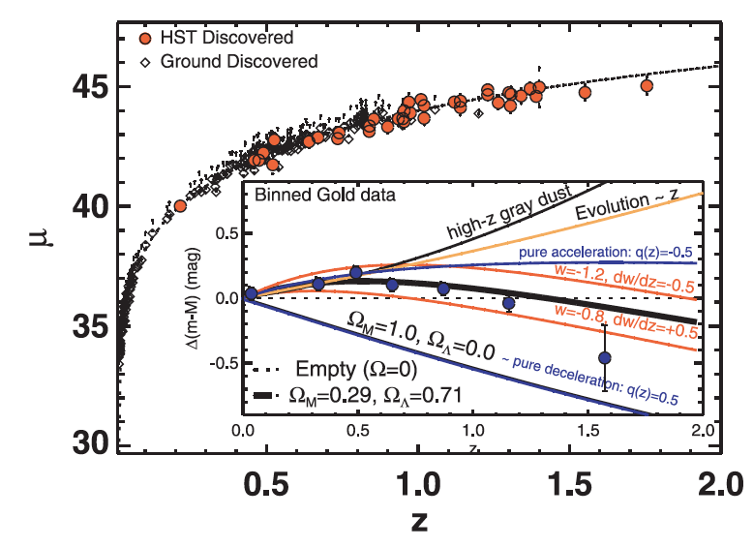
The Expansion of Space: Time Dilation
Cosmological Supernovae
Riess et al. (2007)
Blondin et al. (2018)

Slide 6
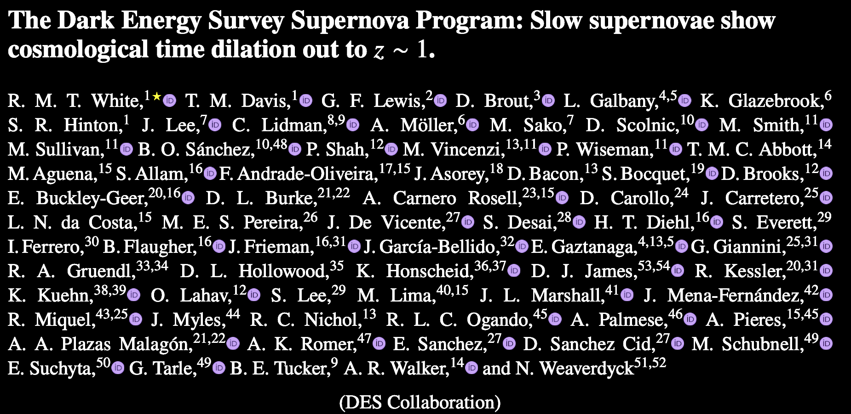
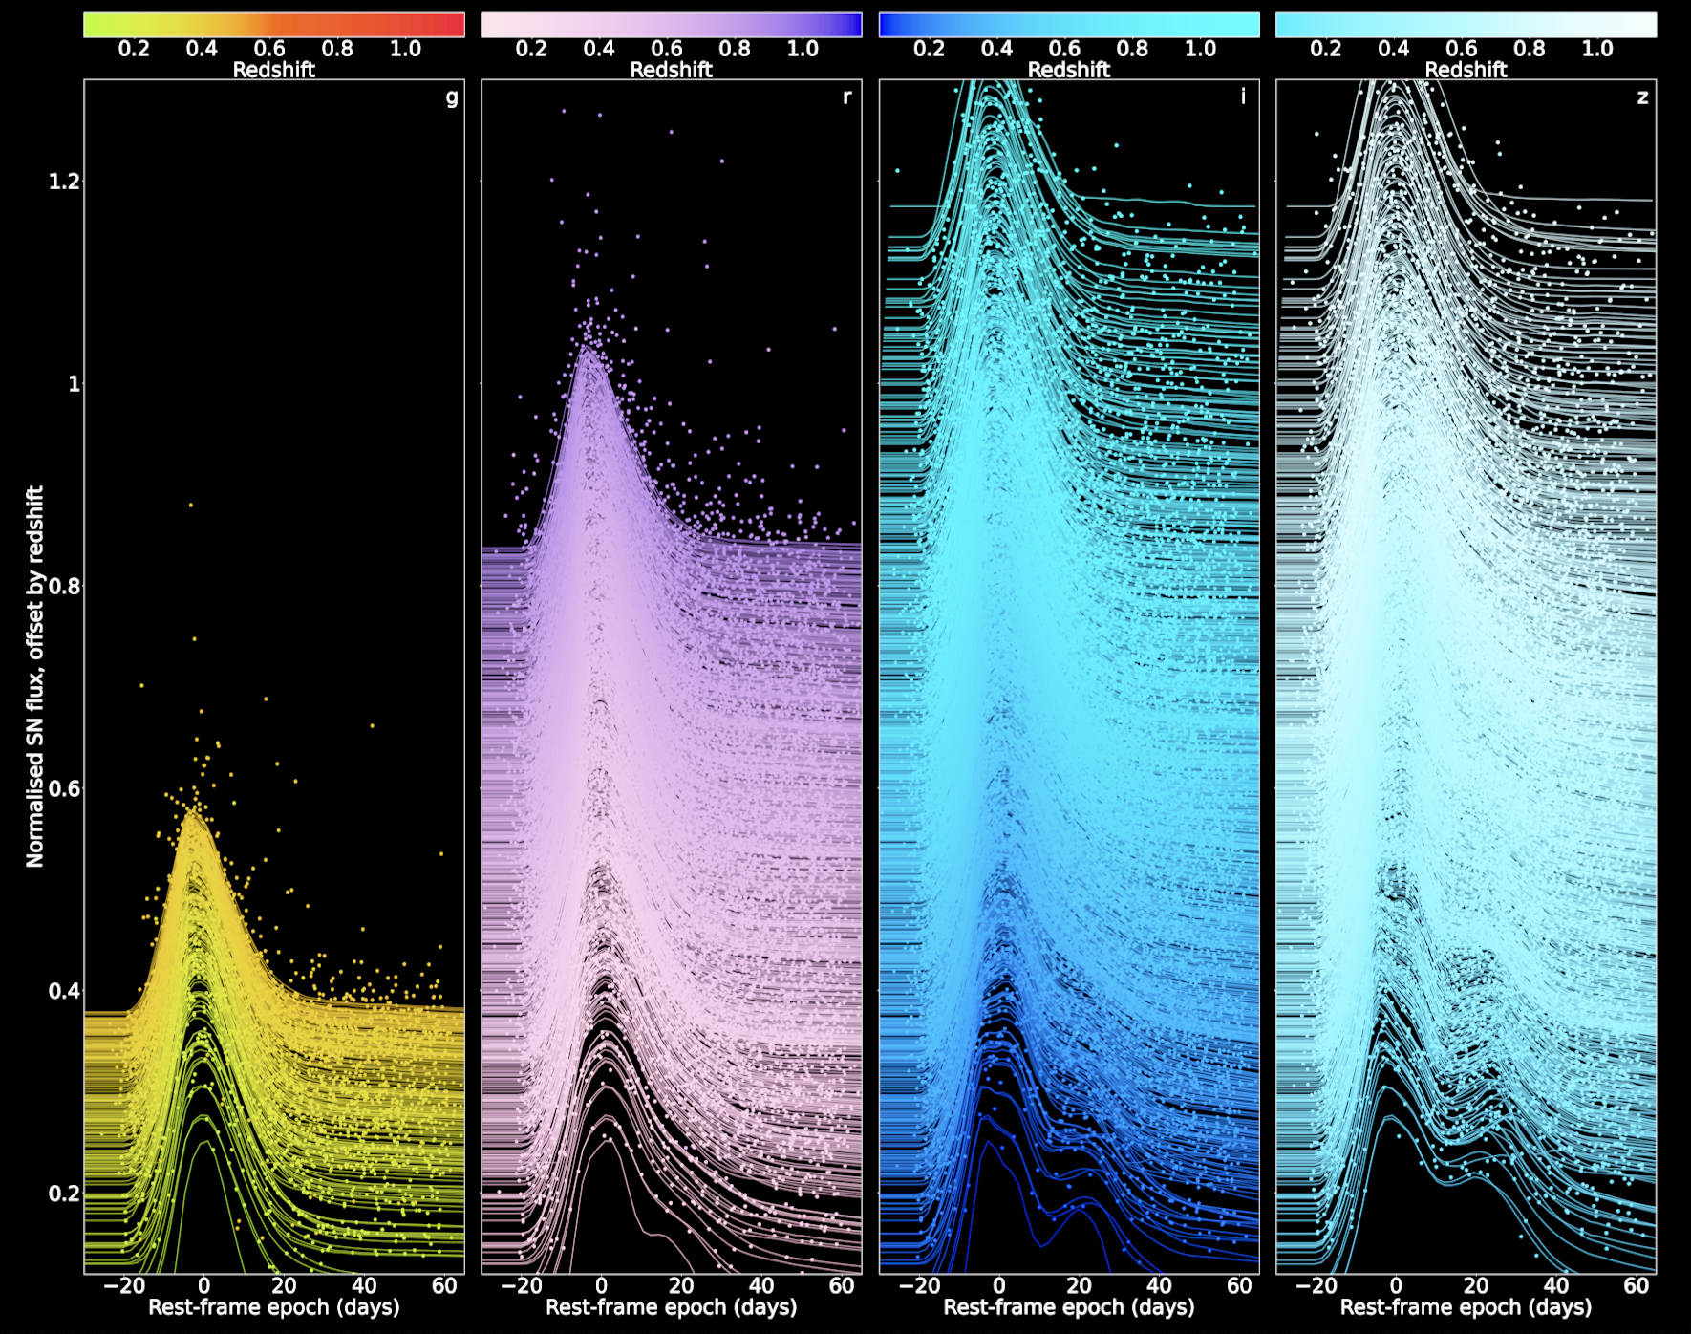
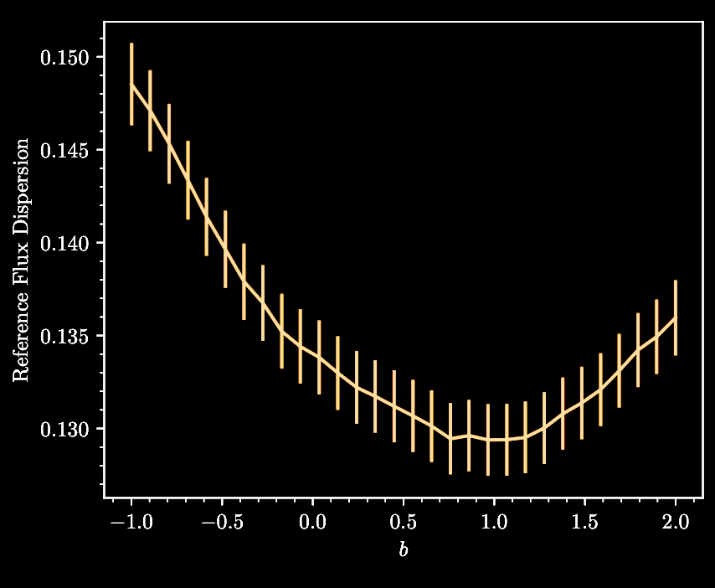
The Expansion of Space: Time Dilation
Abbott et al (2025)

Slide 7
The Expansion of Space: Time Dilation
(1+z)^{b}

Slide 8
The Expansion of Space: Time Dilation
(1+z)^{b}
Typical cosmologist celebrating!

Slide 9
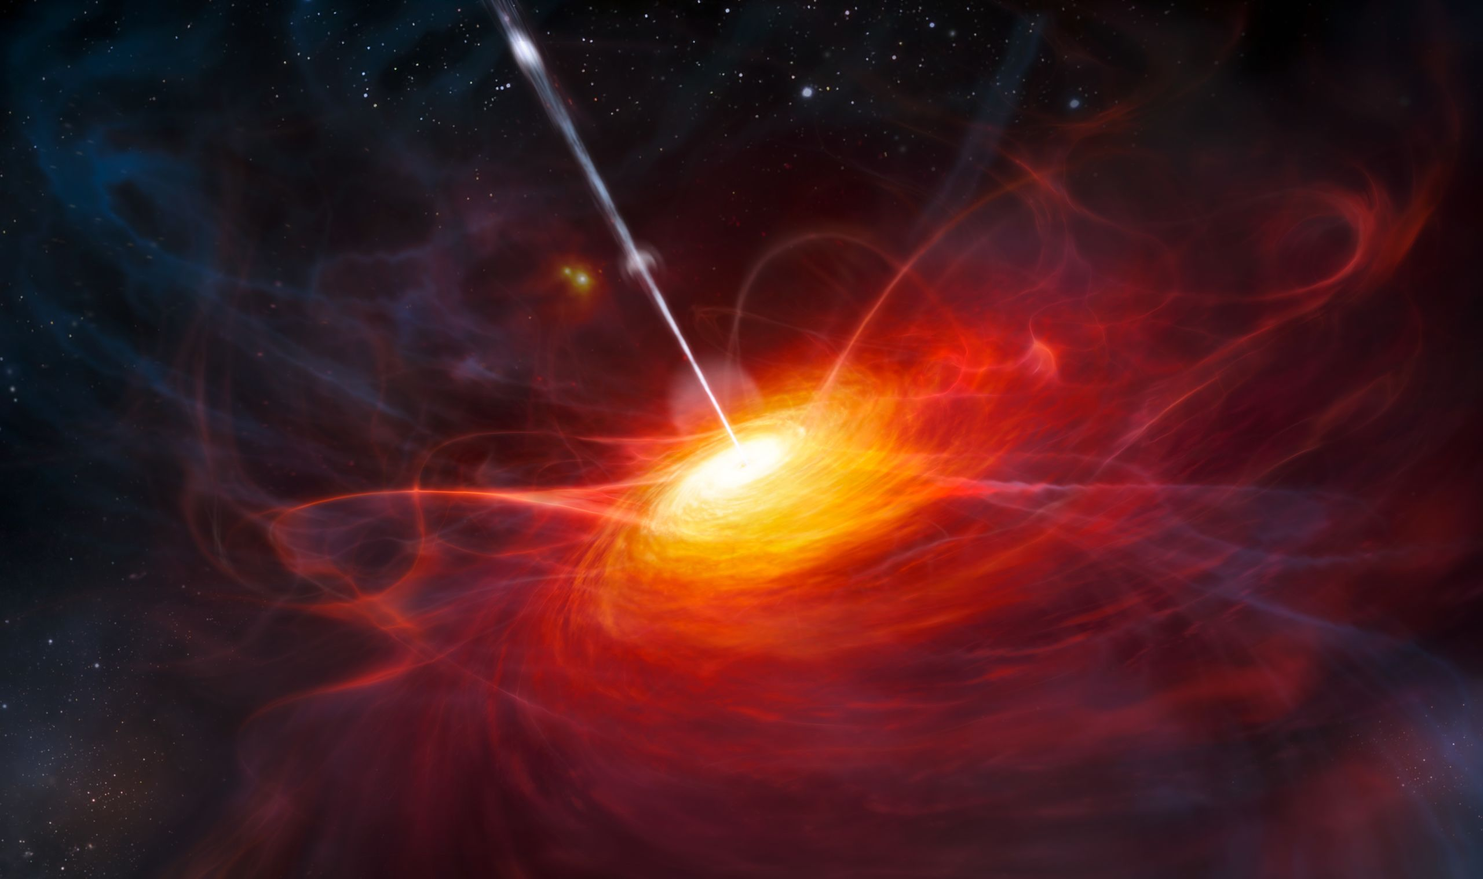
Time Dilation: Quasars
Highly luminous objects.
Supermassive blackhole surrounded by a relativistic accretion disk.
Accretion disk “weather” leads to complicated variability.

Slide 10
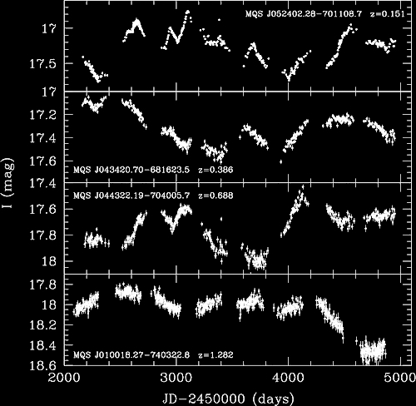
Time Dilation: Quasars

Slide 11
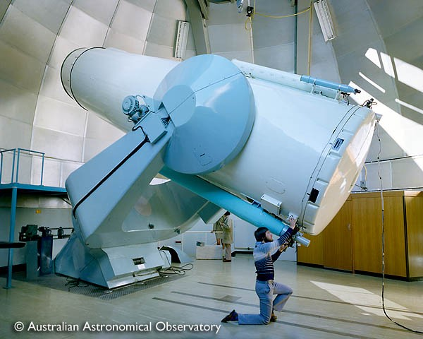
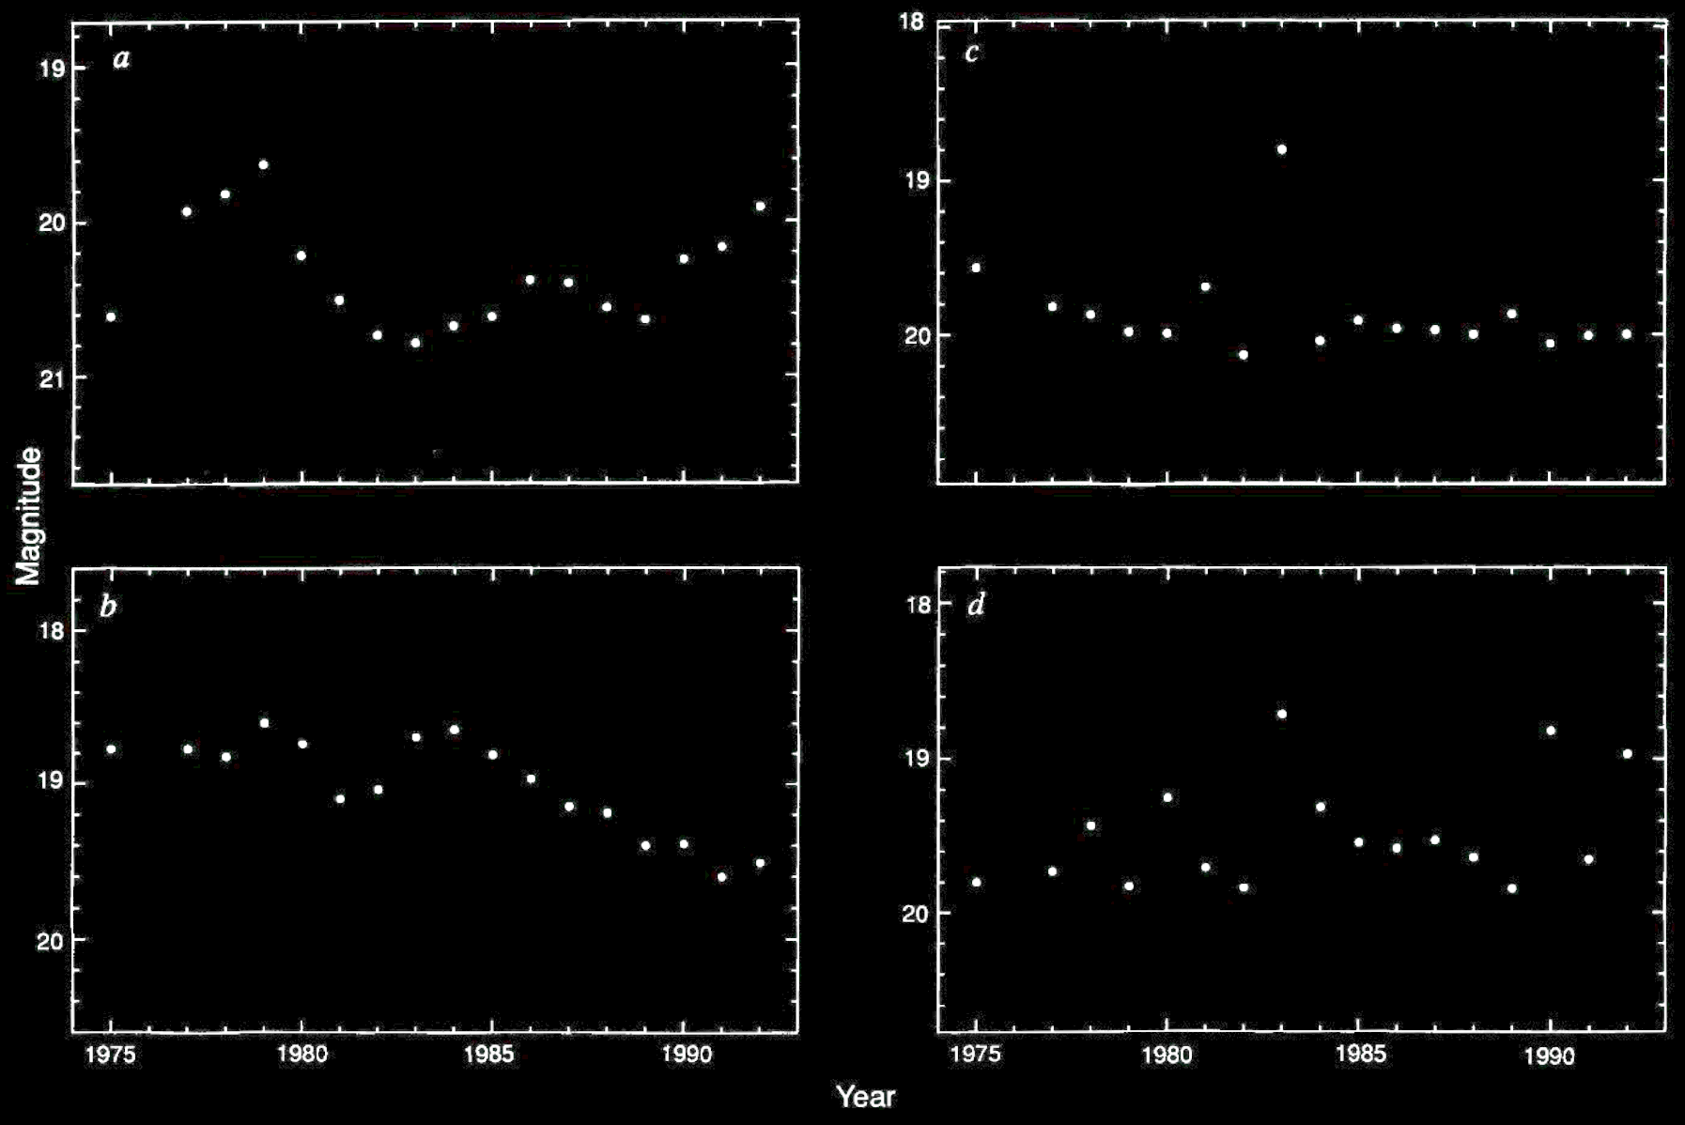
Quasar Light Curves
UK Schmidt Telescope, Australia
Hawkins (1993)

Slide 12
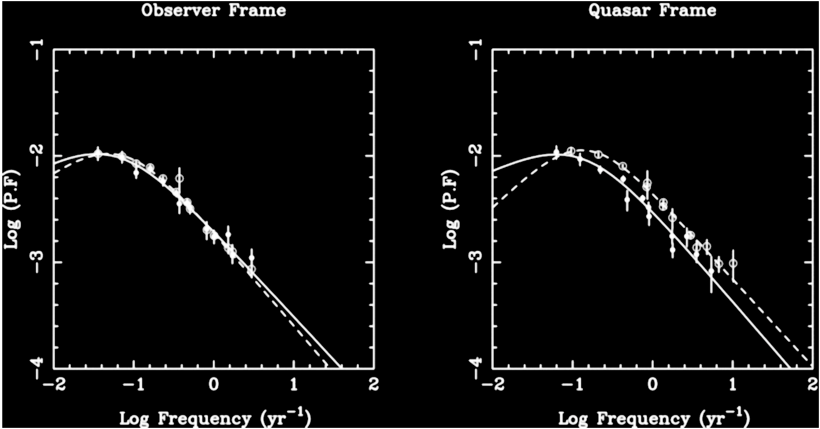
Quasar Light Curves
Hawkins (1993)
Hawkins (2010)

Slide 13
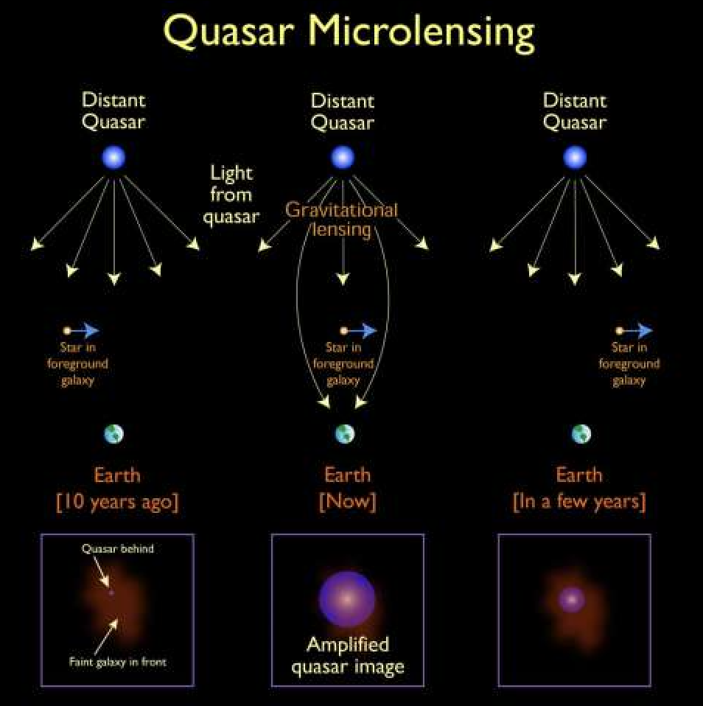
Hawkins concludes that quasar variability cannot be intrinsic.
Proposed it is a result of gravitational microlensing by a significant population of lensing masses (black holes!)

Slide 14
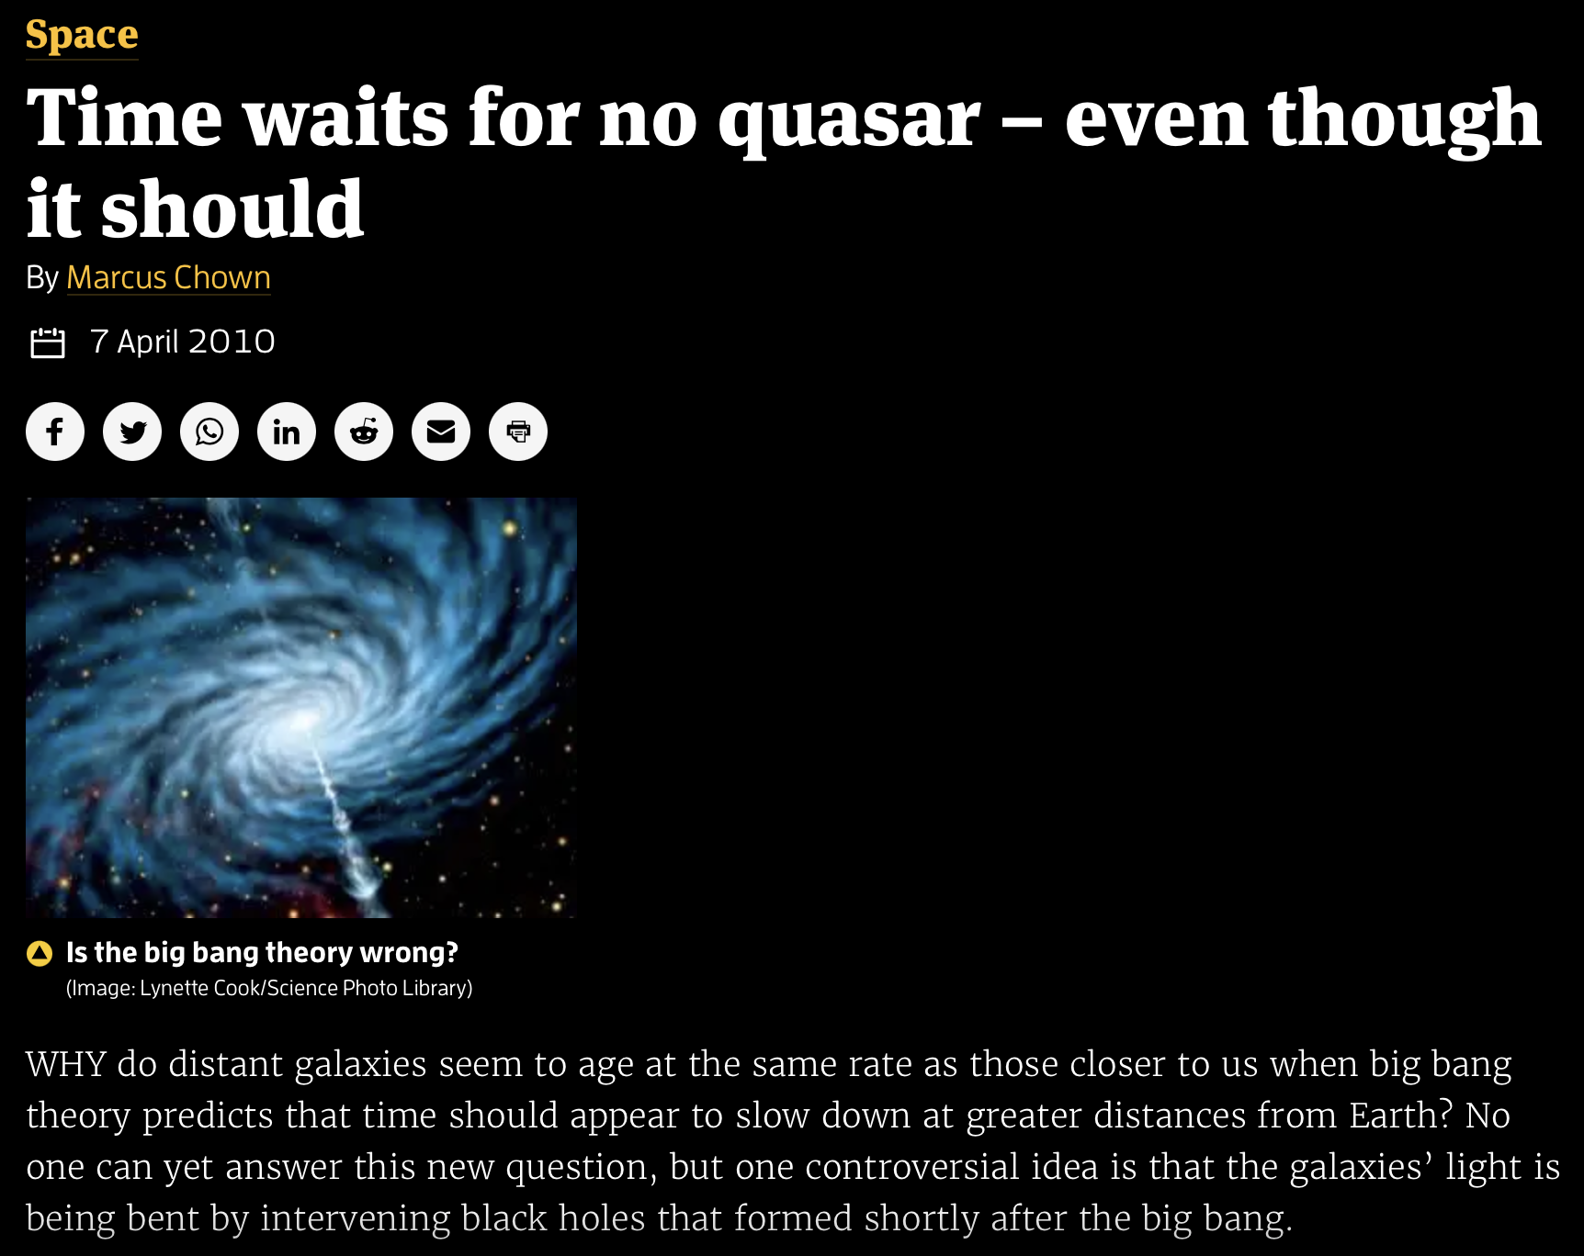

Slide 15
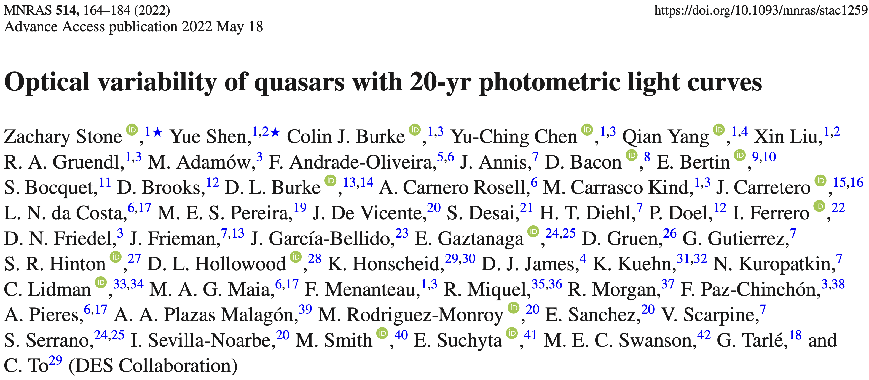
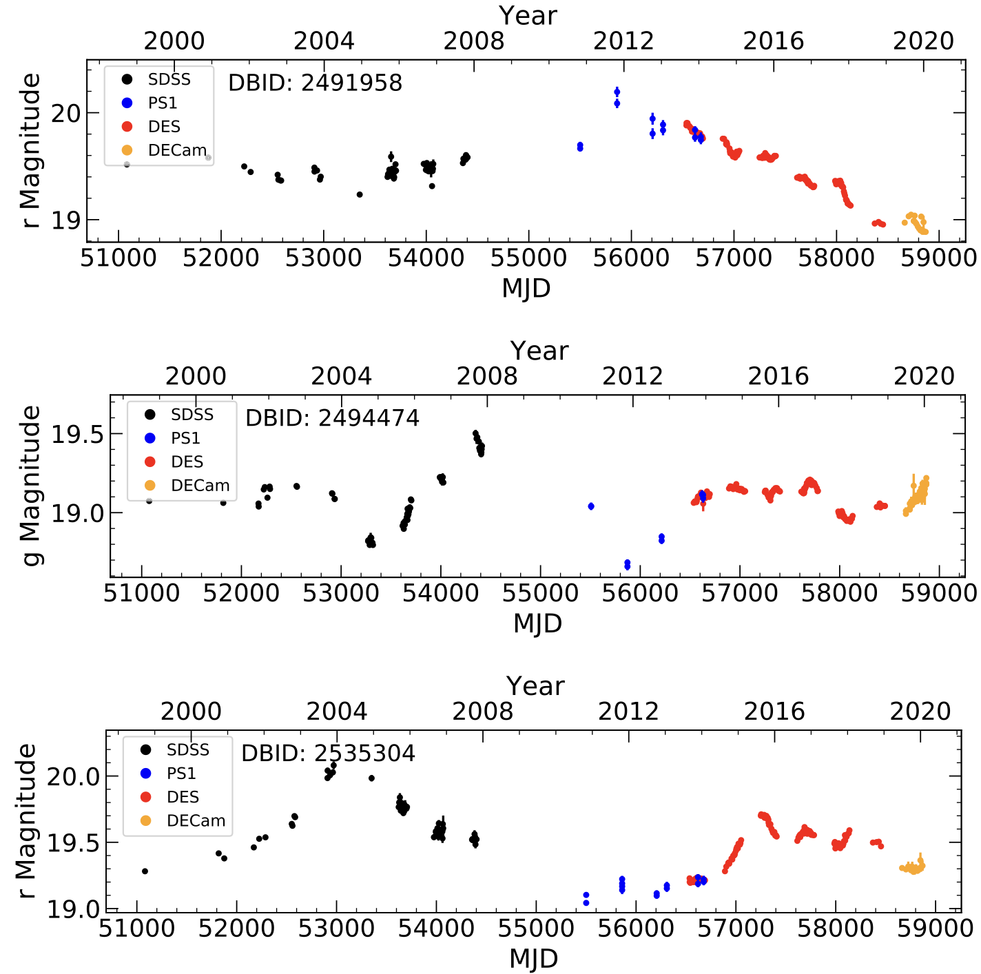
Quasar Light Curves
190 SDSS Quasars
Taken from Stripe 82
Monitored in (g,r,i)
20 years of data
Characterise with
Damped Random Walk
This has characteristic
time scale!
Stone et al. (2023)

Slide 16
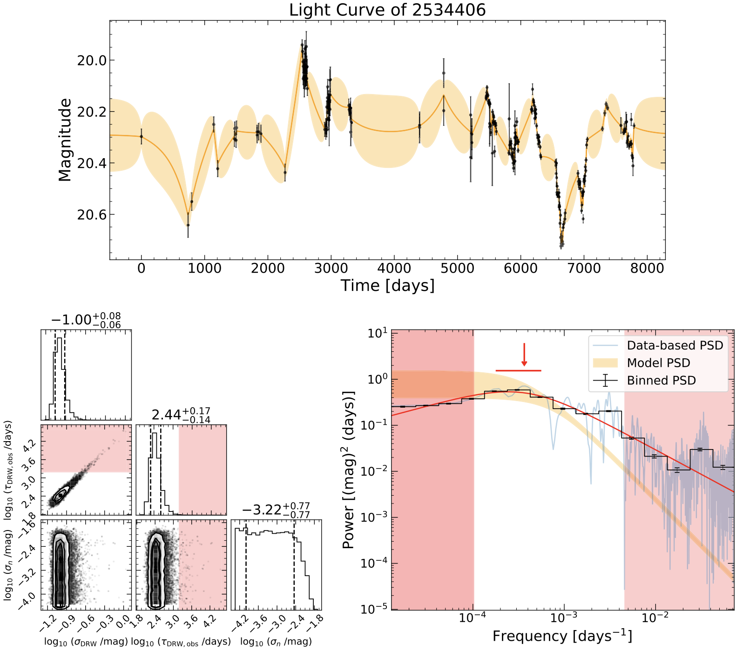
Quasar Light Curves
190 SDSS Quasars
Taken from Stripe 82
Monitored in (g,r,i)
20 years of data
Characterise with
Damped Random Walk
This has characteristic
time scale!
Stone et al. (2023)

Slide 17
Quasar Light Curves
Represent as a Damped Random Walk
Covariance matrix between two observations.
Importantly, this has a *time scale* which is imprinted on the structure function and power spectrum density.
Calculated for each quasar by Stone et al. (2023).

Slide 18
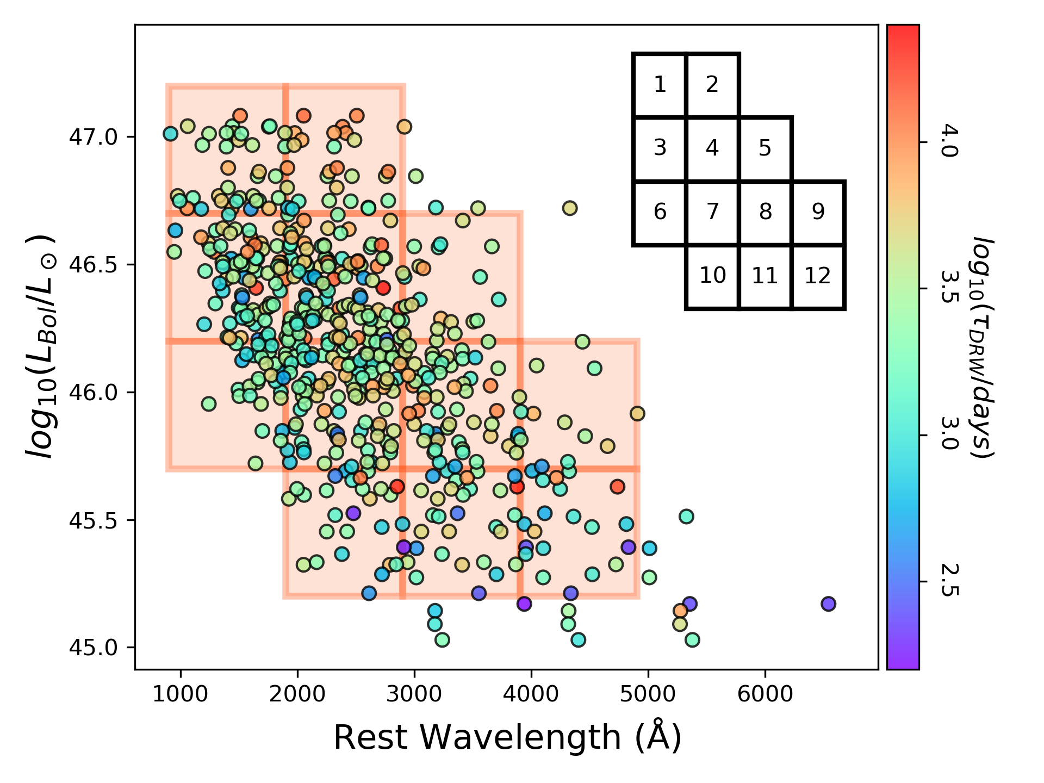
Quasar Light Curves
Method:
Bin quasars in Rest Wavelength vs Luminosity
Assume quasars in same bin have same variability
Assume redshift dependence of the log(timescale) of the form:
Test different hypotheses using Bayesian evidence
<- erg/s
Lewis & Brewer (2023)

Slide 19
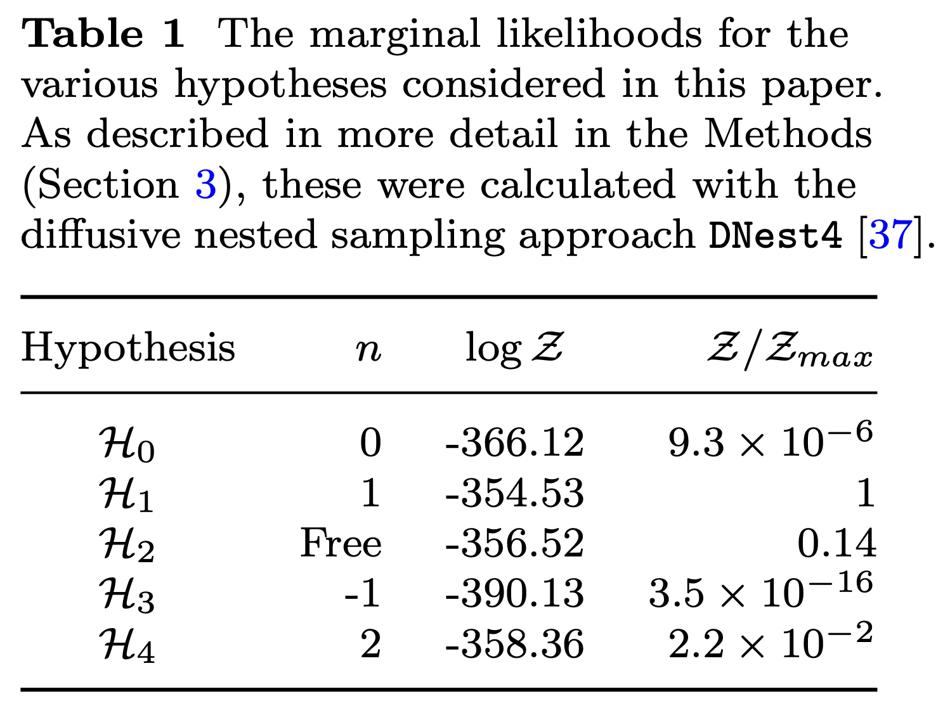
Bayesian Analysis
The standard cosmological expectation is n=1
Lewis & Brewer (2023)

Slide 20
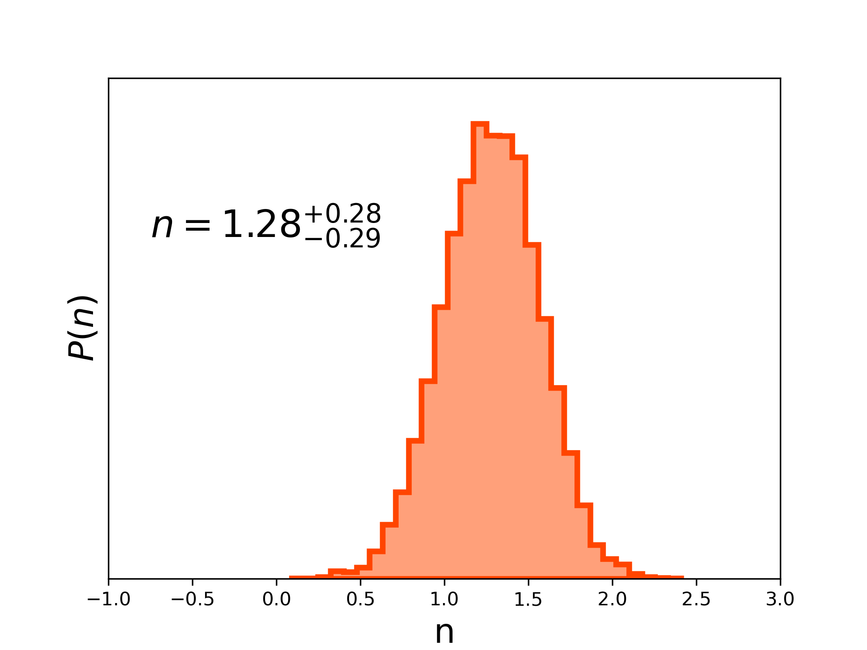
Bayesian Analysis
For H2, where n is treated as a free parameter, the resultant distribution is consistent with n=1.
Note that n=0 is strongly disfavoured.
Lewis & Brewer (2023)

Slide 21
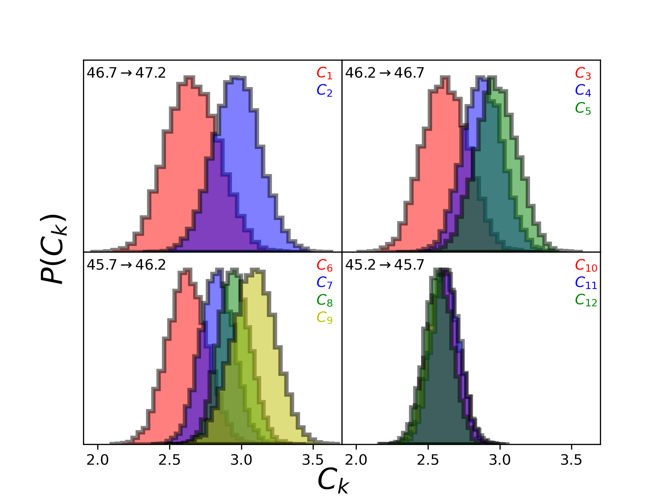
Bayesian Analysis
The distribution of the Ck parameters shows that there are systemic differences between the bins.
This shows that there are aspects of “quasar physics” influencing the light curves.
Lewis & Brewer (2023)

Slide 22
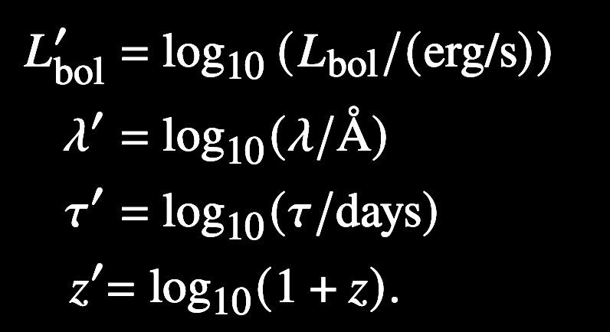
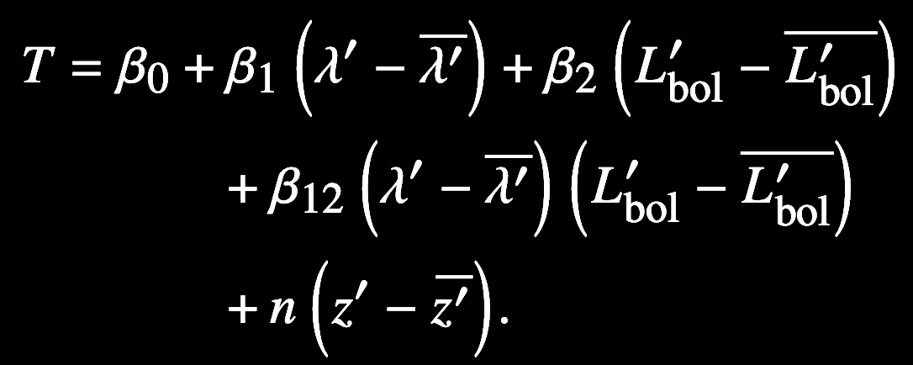
Replace the discrete representation with a continuous function over the λ – L_{bol} space.
Also include a “scatter” term, σ, for each of the quasars.
Brewer, Lewis and Li (2023)

Slide 23
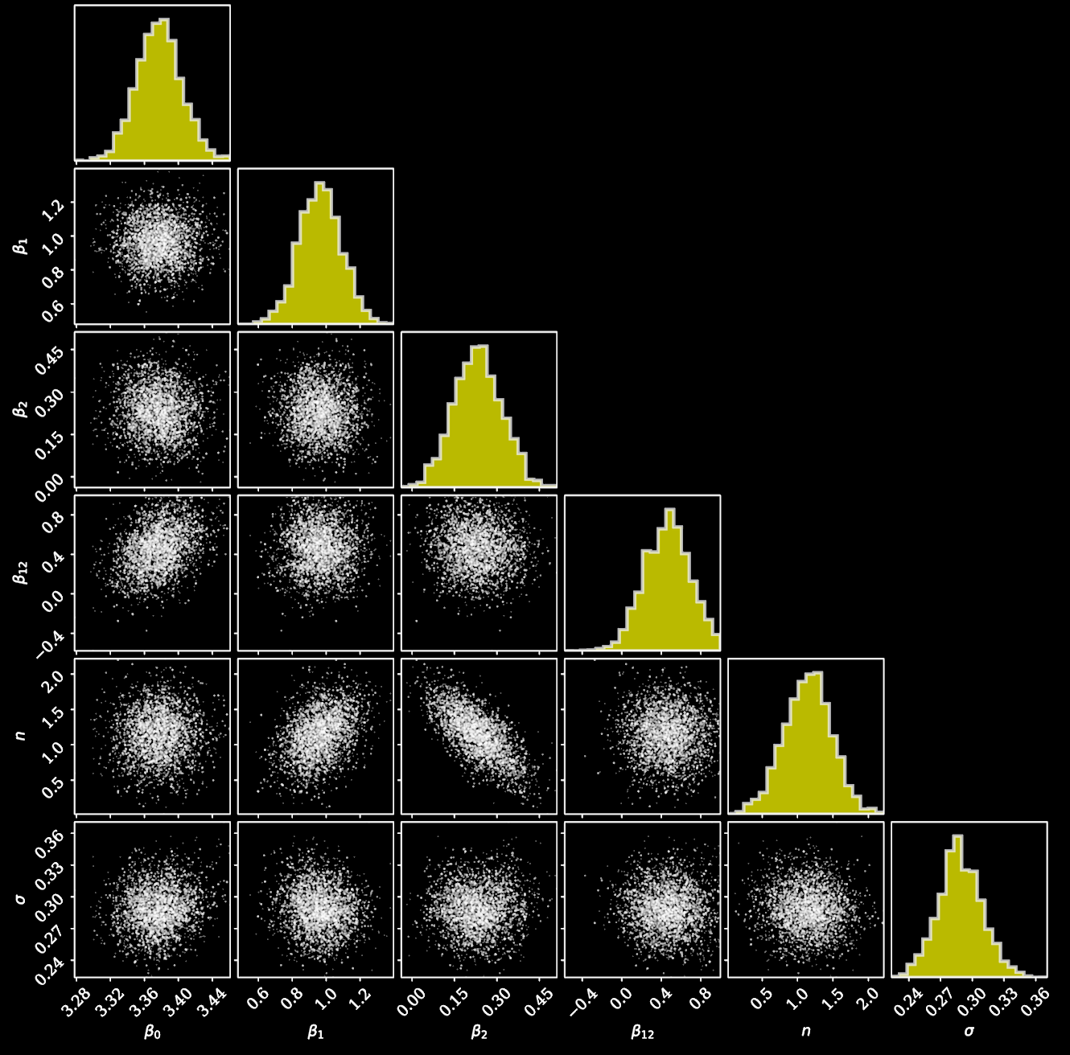
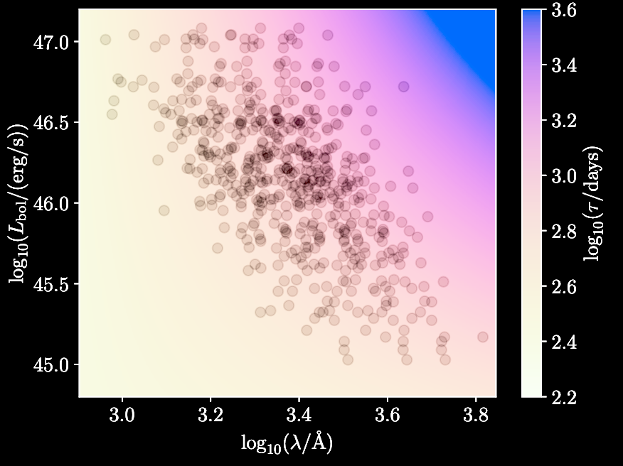
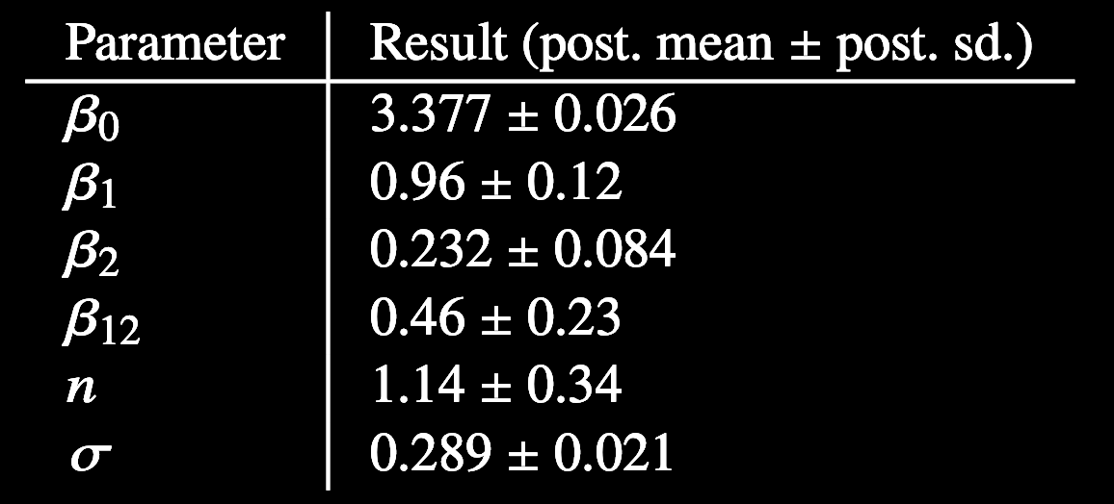
N = 1.14 ± 0.34
Brewer, Lewis and Li (2023)

Slide 24
Conclusions
Previous claims that quasar variability does not exhibit the expected cosmological time dilation due to expanding space.
We have found the expected cosmological signature by analysing a new sample of 190 quasars monitored over 20 years.
Counters more radical claims (cosmological distribution of microlensing masses, a static universe, tired light etc).
Little indication of significant evolution, so future samples can distinguish the influence of quasar physics from the cosmological signature, so quasars can be used as standard candles/clocks.
Lewis & Brewer (2023) & Brewer, Lewis & Li (2025)

