Slide 1
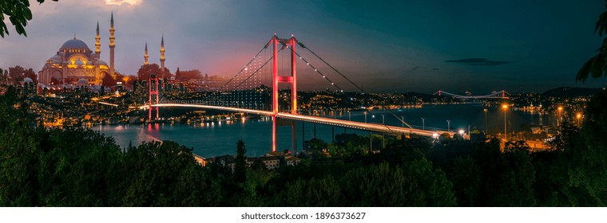
Outer regions of galaxy clusters as a new probe to test modifications to gravity
Minahil Adil Butt
In Collaboration With: Sandeep Haridasu, Antonaldo Diaferio, Francesco Benetti, Andrea Lapi, Carlo Baccigalupi

Slide 2
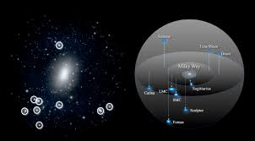
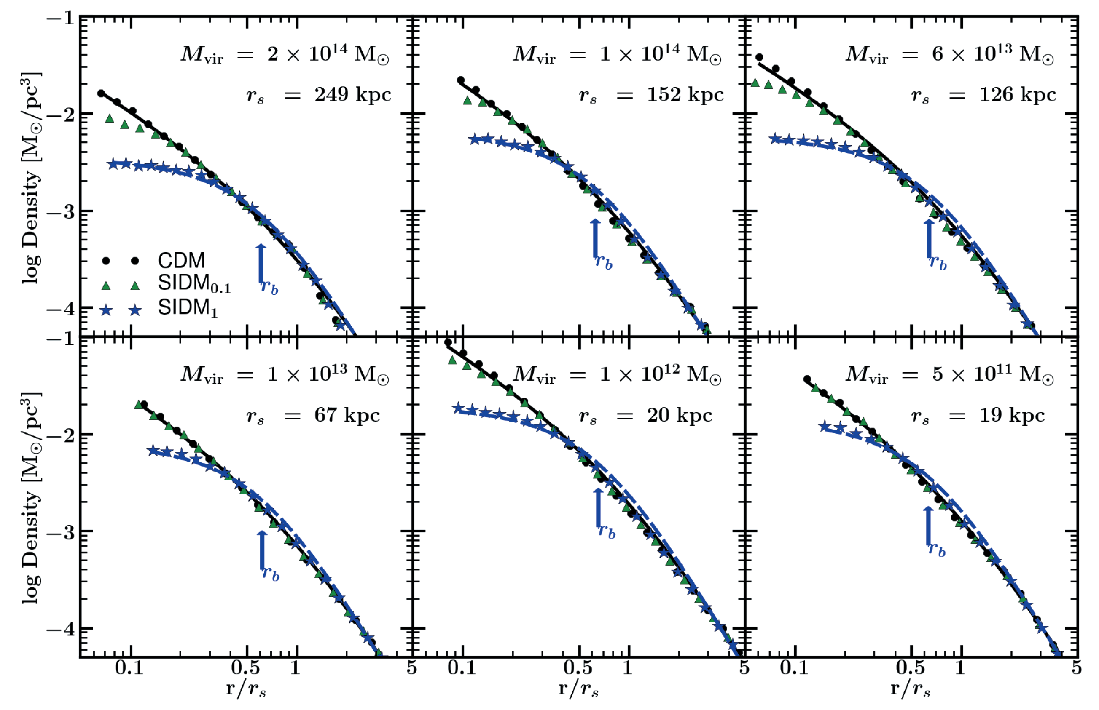
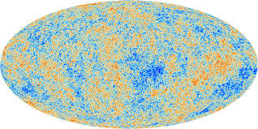
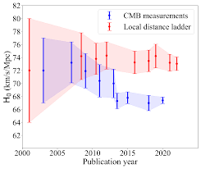
$ΛCDM$ is one of the most widely accepted model for the structure and evolution of the universe

Slide 3
Beyond GR: Modified Gravity
When dark matter searches come up empty and tensions grow, it’s time to ask ourselves: are we using the wrong gravity?
0.001 cm
1 AU
1 kpc
1 Mpc
1000 Mpc
GR
MOND
MG

Slide 4
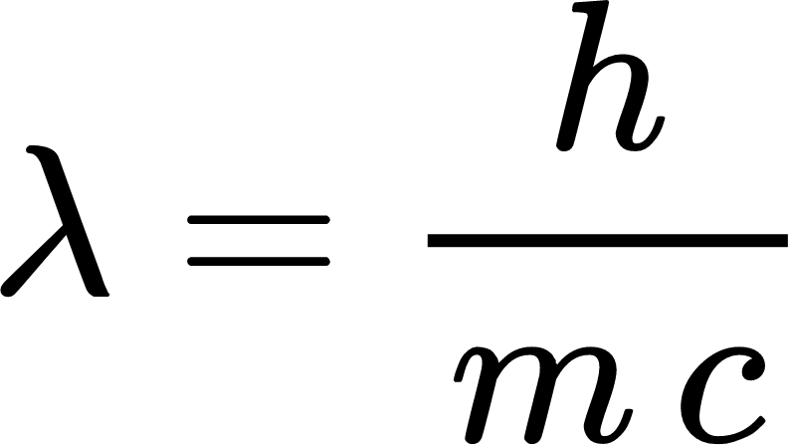
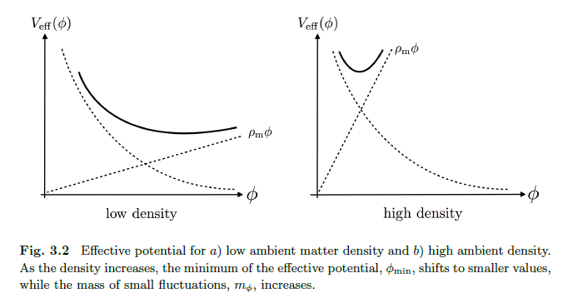
Modified Gravity – Chameleon Screening
Terukina’13

Slide 5
Chameleon Screening: Modified Potential

Slide 6
Possible Probe: The Caustic Method
Diaferio’05

Slide 7
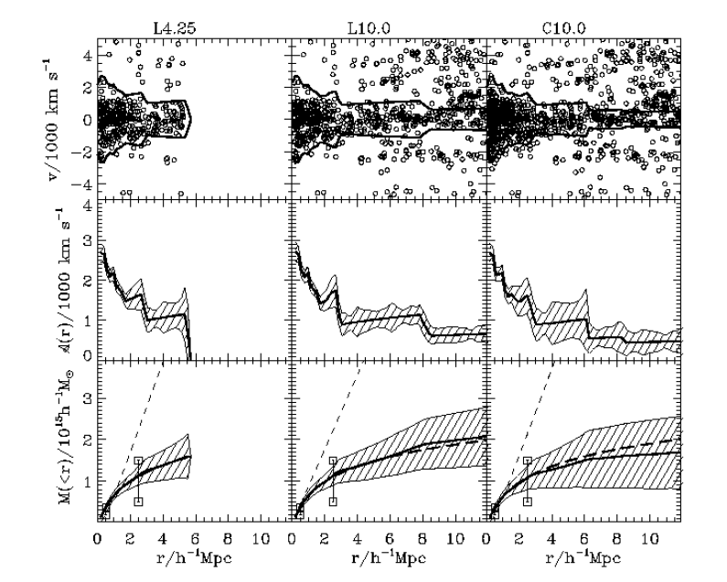
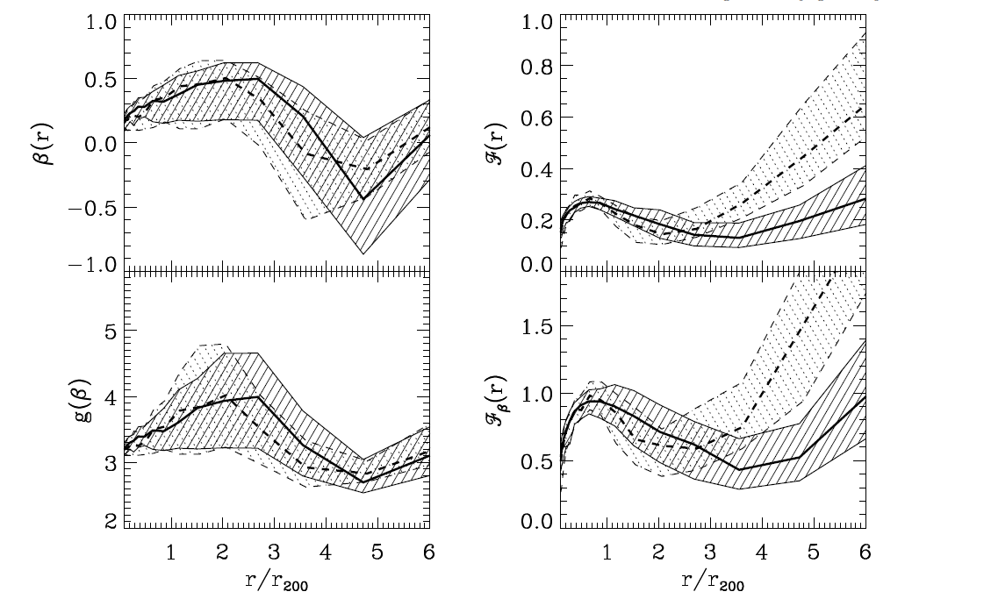
Most literature takes $ℱ_{β}=0.5$ or $ℱ_{β}=0.65$
We do a full analysis in Butt et al. 2024
Diaferio’99, 09

Slide 8
In Butt et al. 2024 we study two clusters:
A2029 (982 galaxies)
A2142 (2239 galaxies)

Slide 9
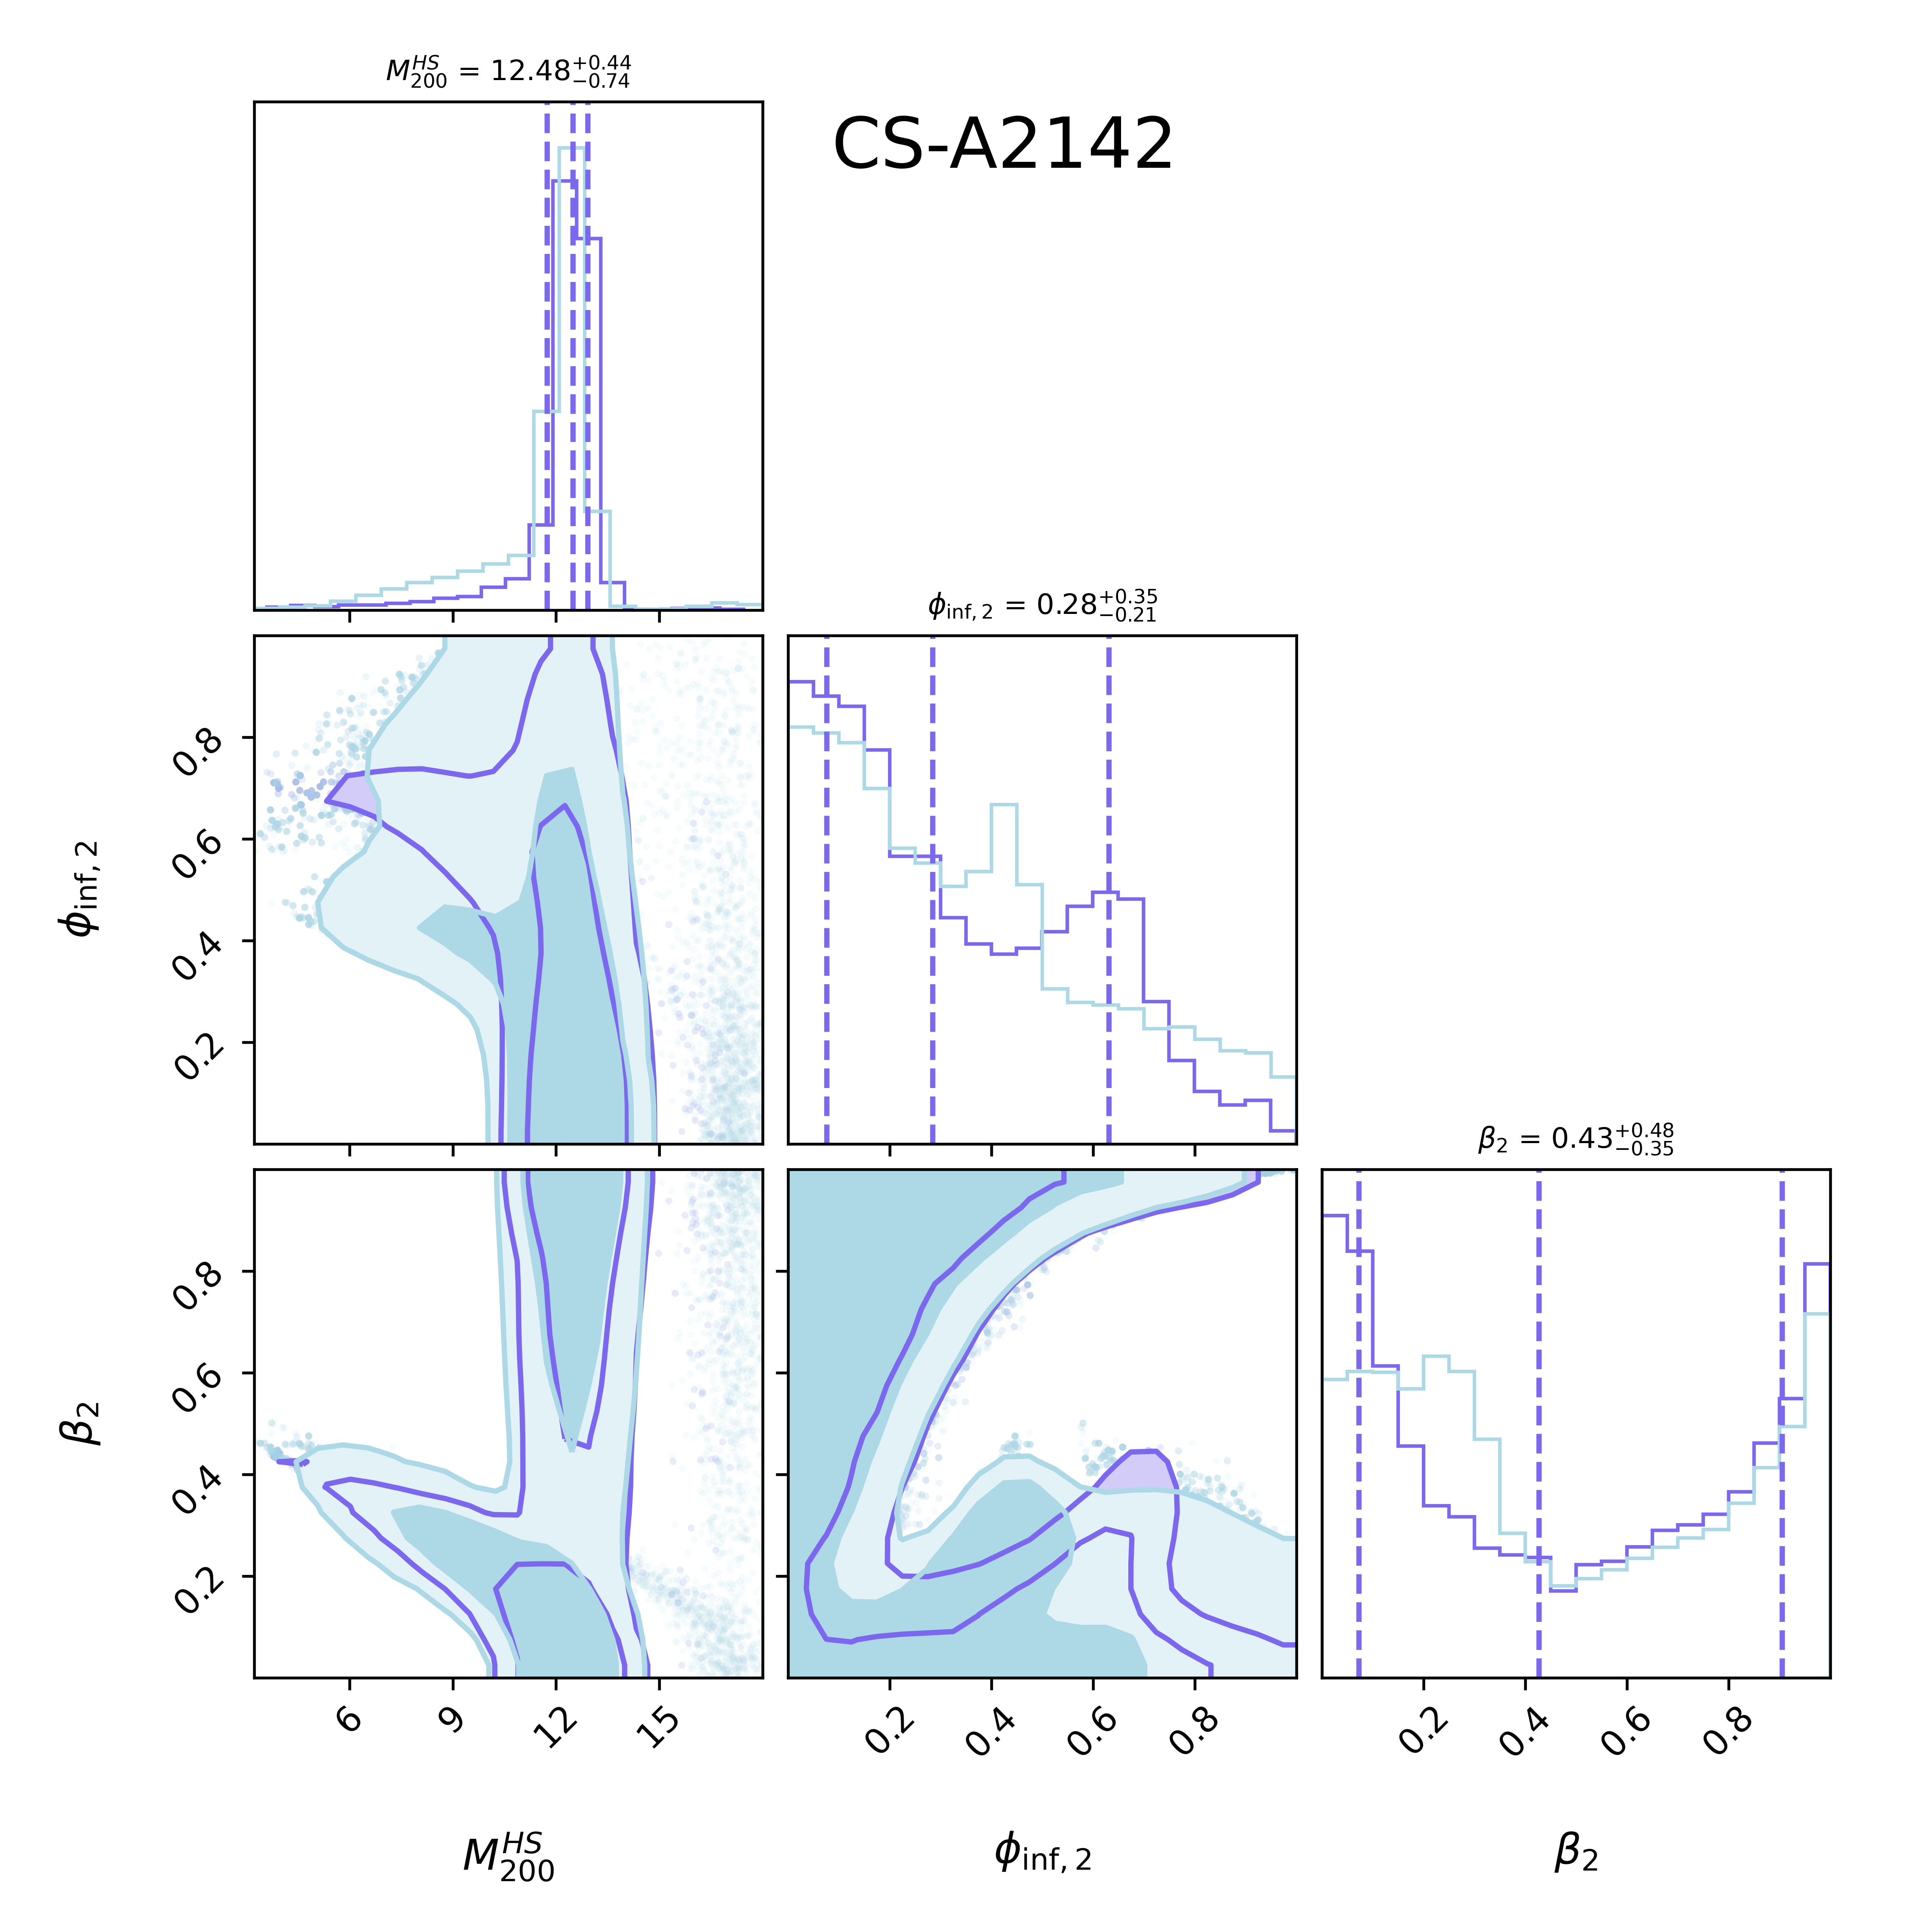
Results - CS
$φ_{∞,2}≤0.18$ at $3σ$ C.L.

Slide 10
The Caustic Method
Independent of the dynamical state of the cluster and effective for individual cluster analysis.
Dependent on accurate galaxy velocity measurements and limited by the number of spectroscopically confirmed members.
STACKED CLUSTERS!

Slide 11
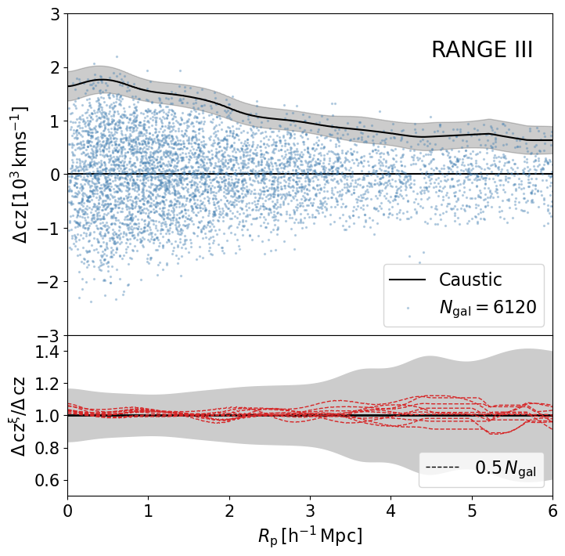
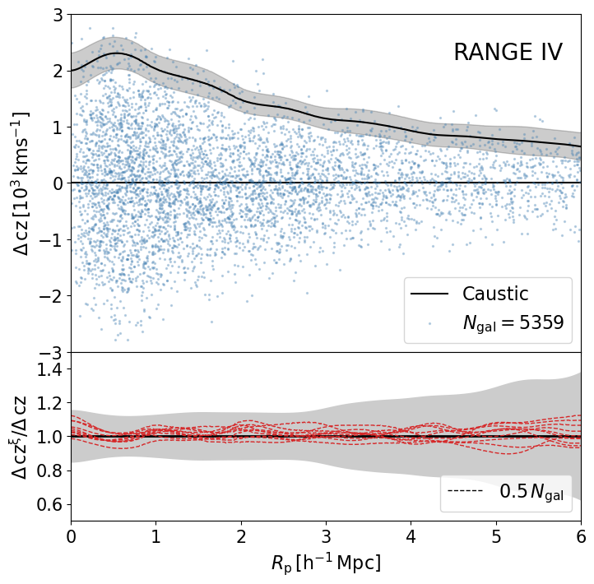
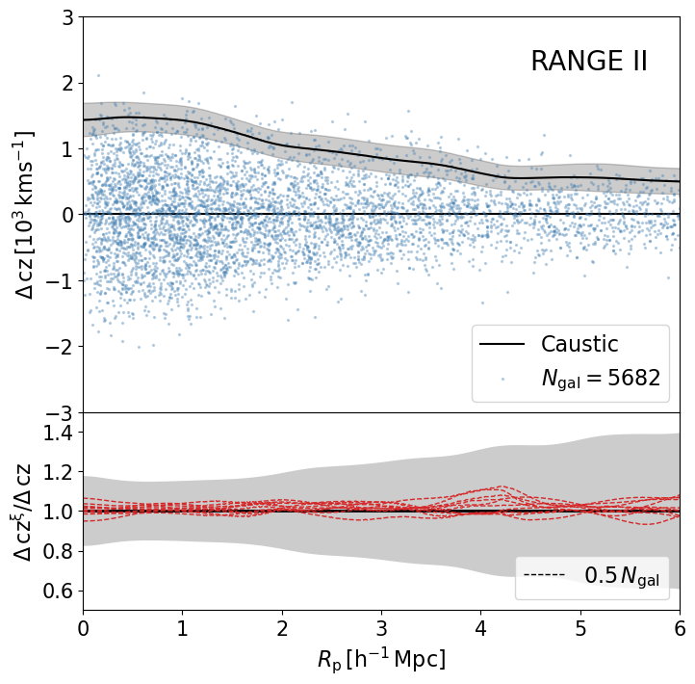
Stacking Clusters
$$3.74−5.85 ({10}^{14}M_{⊙})$$
$$5.85−18.64 ({10}^{14}M_{⊙})$$
$$0.30−2.40 ({10}^{14}M_{⊙})$$
$$2.40−3.74 ({10}^{14}M_{⊙})$$

Slide 12
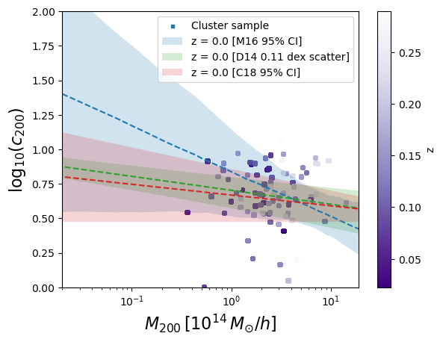

Slide 13
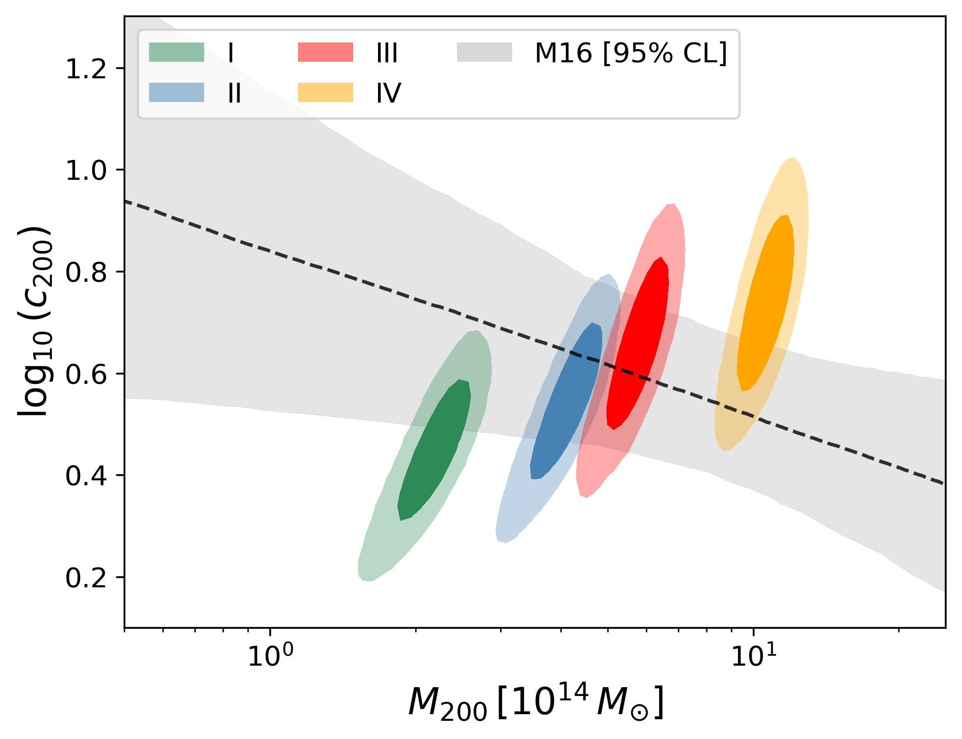
Concentration-Mass relation
$$A=3.66±0.16, B=−0.14±0.52, C=−0.32±0.18$$

Slide 14
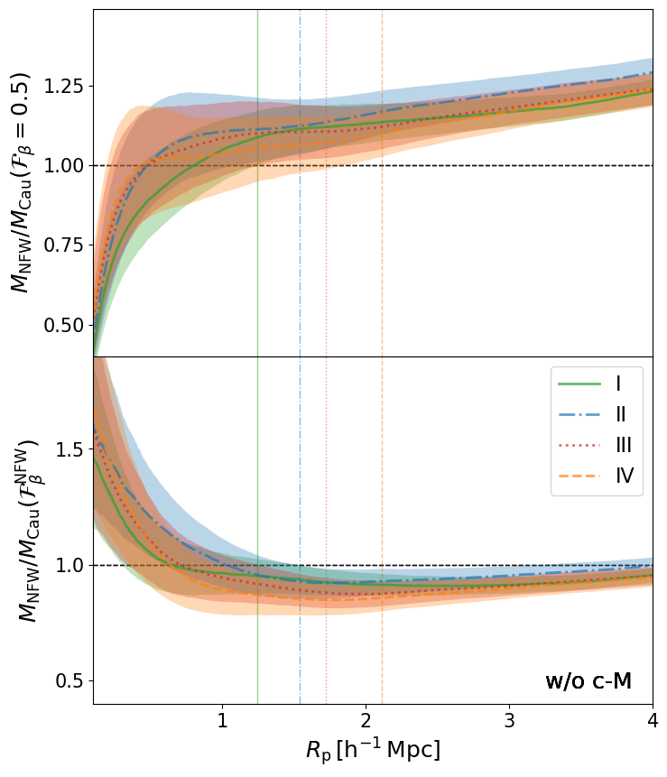
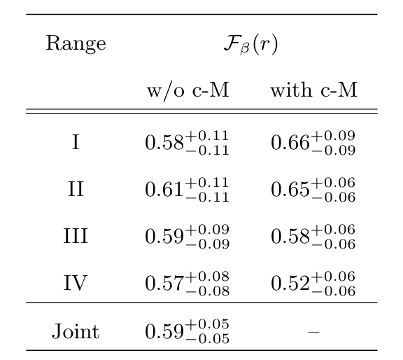
Constraints on${ ℱ}_{β}(r$)
In contrast with $ℱ_{β}=0.4$ estimated from the IllustrisTNG compilation.
(Pizzardo et al. ’23)
Notes:
Bottom left should be unity but bias could exist due to fixed anisotropy. Could assess anisotropy like that.
Right: Cm introducing mass range dependent bias

Slide 15
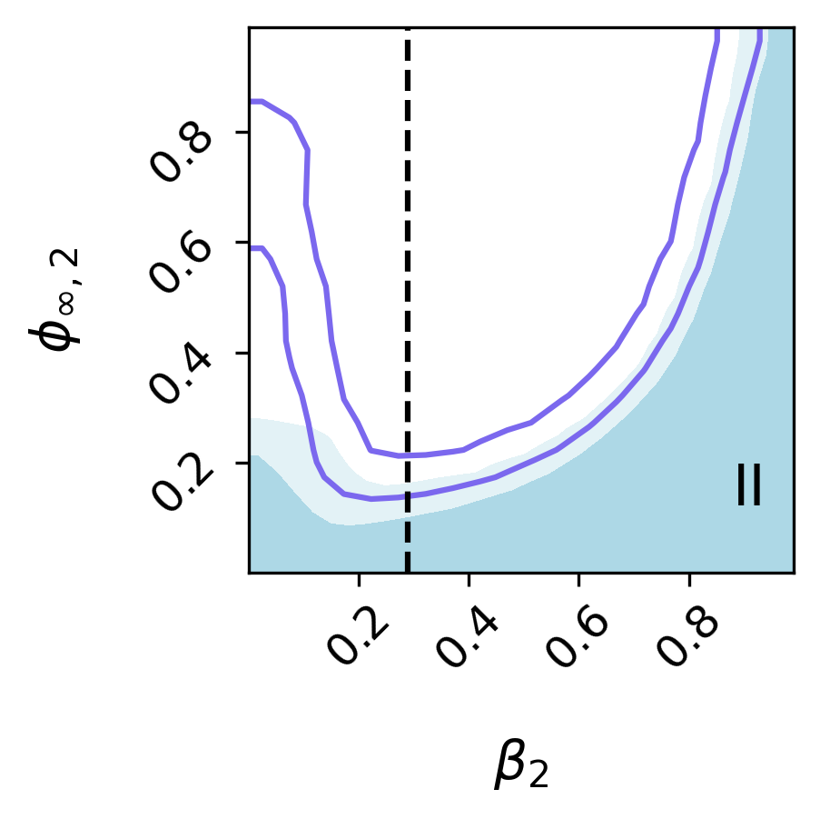
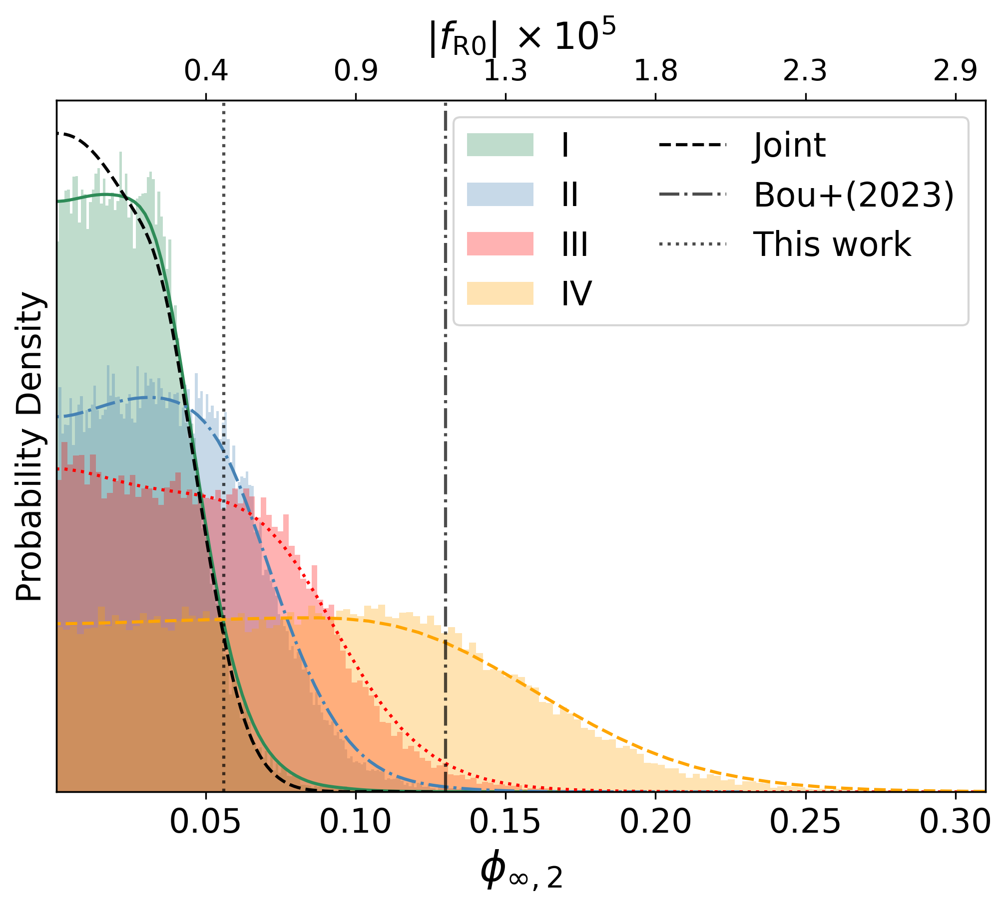
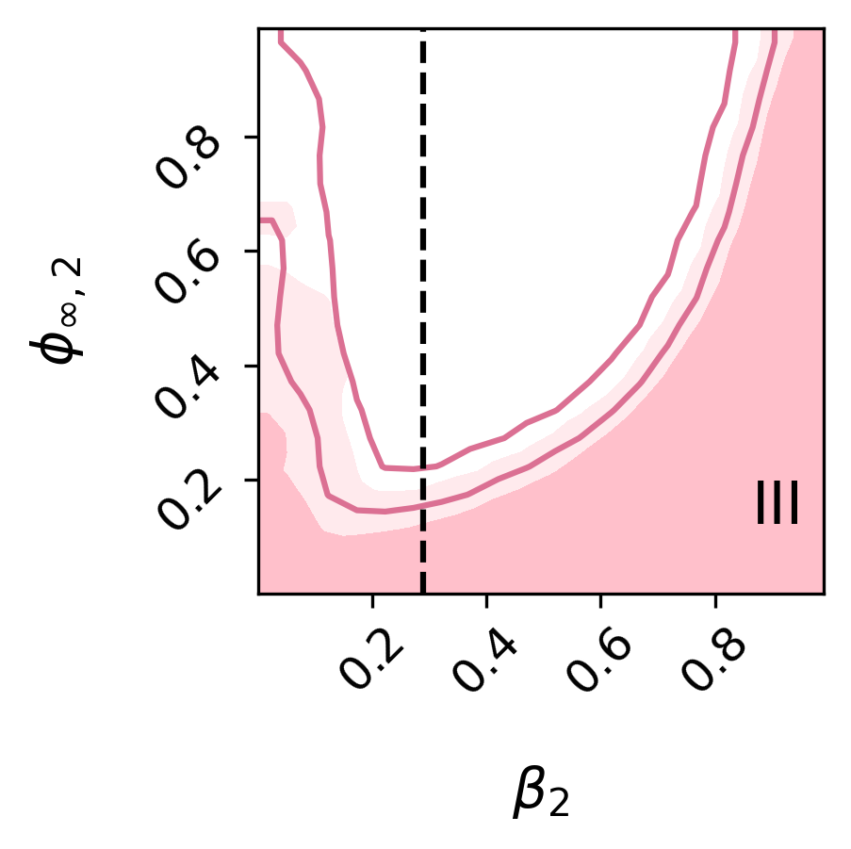
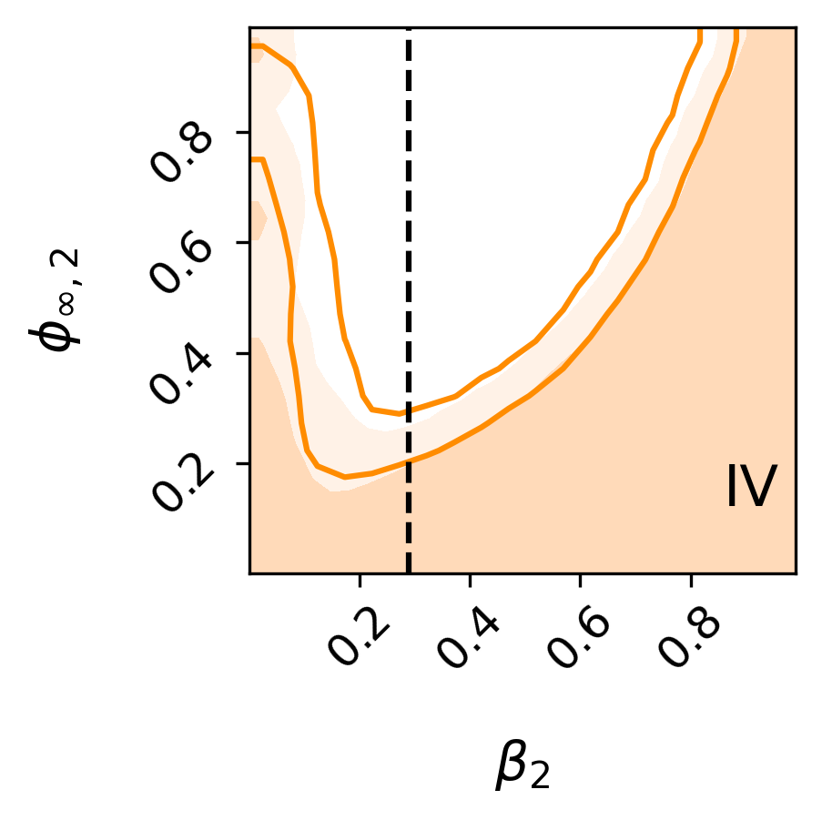
Constraints on Modified Gravity
$$φ_{∞,2}=1−\exp{(φ_{∞}{10}^{−4}M_{Pl})}$$
$$β_{2}=β/(1+β)$$
Notes:
Filled with cM
Mass beta degeneracy alleviated probably due to the fact that we use potential directly. Bou used WL priors to combat it but we don’t need to.

Slide 16
Thank you for your attention!

Slide 19
