Slide 1
1
Maria Giovanna Dainotti
Machine learning on the rescue
to support GRB and SNe Ia cosmology
24/06/2025, CosmoVerse, Istanbul

Slide 2
2
Di Valentino, Said et al. 2025, PDU

Slide 3
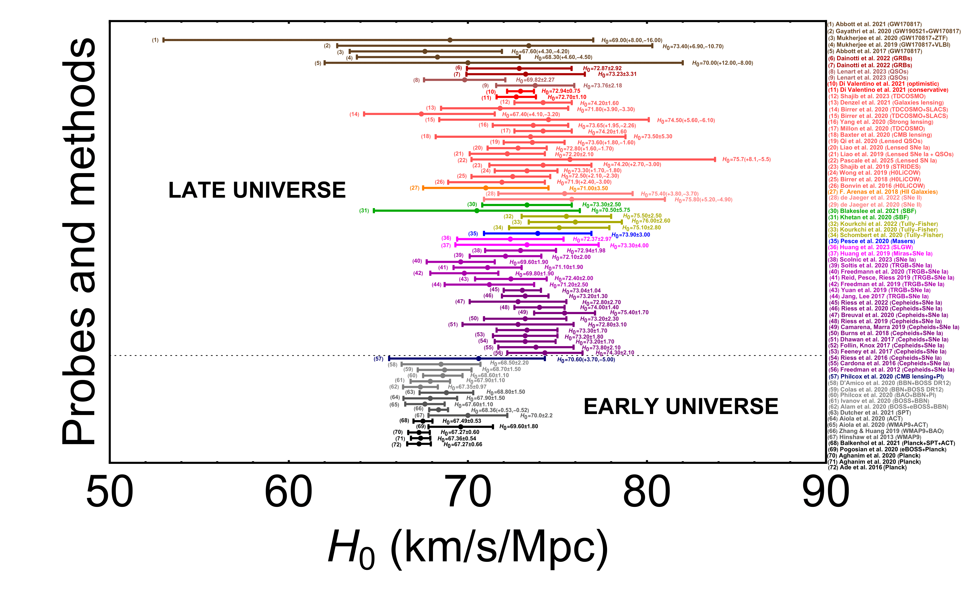
From M. G. Dainotti et al. 2025 (JHEAP 48, August 2025, 100405)
M. G. Dainotti, et al., 2021, ApJ, 912, 150

Slide 4
New Analysis with a combination of sample: The Master sample
17
Pantheon, PantheonPlus, JLA, and DES: 3789 SNe Ia.
Duplicate entries removed by assigning priority to catalogs in the following order: DES, Pantheon+, Pantheon and JLA.
The order priority chosen for comparison with the DES sample
Two binning techniques: equi-populated, equi-spacing and moving window
Paper is now published:
M. G. Dainotti et al. 2025 (JHEAP 48, August 2025, 100405)

Slide 5
18
Results
Fitting $ℋ_{0}(z)$
Checking the $\frac{α}{σ_{α}}$
Is $\frac{α}{σ_{α}}>1$?
NO
Skip
YES
Is $ℋ_{0}(z=1100)$ compatible in $1σ$ with $H_{0,CMB}$?
Diamond
YES
NO
Gold
M. G. Dainotti, et al., 2021, ApJ, 912, 150

Slide 6
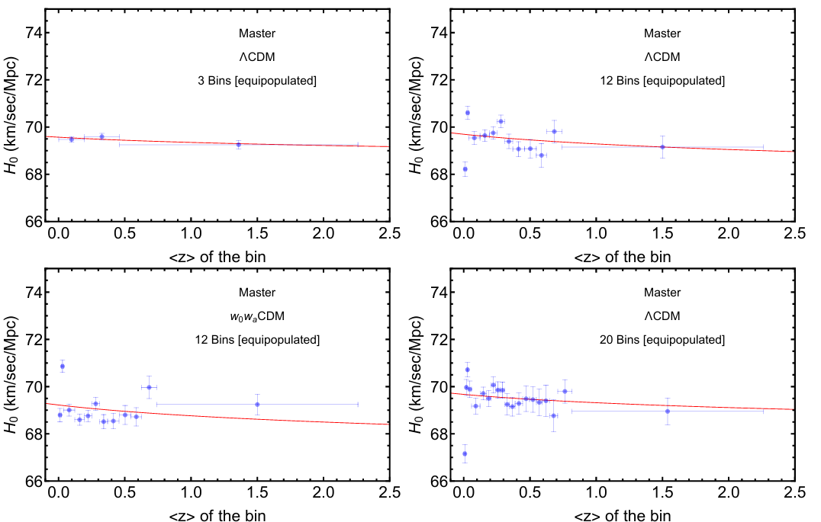
21
Results: Master Sample
This decreasing trend confirms earlier works
Dainotti, et al., 2021, ApJ, 912, 150
Kazantzidis and L. Perivolaropoulos
Phys. Rev. D 102, 023520
Dainotti, et al., 2022, Galaxies, 10, 1, 24
For the theoretical interpretation see Fazzari talk
M. G. Dainotti, et al., 2021, ApJ, 912, 150

Slide 7
What do to next? Add Gamma Ray Bursts

Slide 8
2
For 20 years, we’ve been struggling: how to use GRBs as standard candles?
Challenge: Light curves vary widely - “if you've seen one GRB, you've seen one GRB”
Swift lightcurves taken from the Swift repository

Slide 9
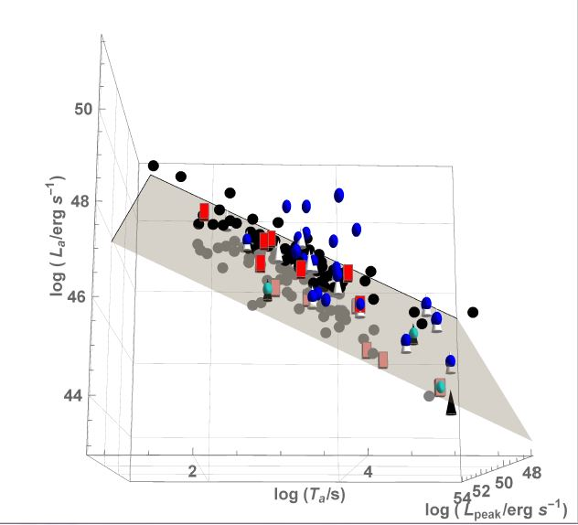
3
AN intrinsic Correlation build for Cosmology
Press release by NASA and press conference at the AAS June 2016:
https://swift.gsfc.nasa.gov/news/2016/grbs_std_candles.html
Mention in Scientific American, Stanford highlight of 2016, INAF Blogs, UNAM gaceta, and many online newspapers took the news.
M. G. Dainotti, S. Postnikov, X. Hernandez, M. Ostrowski, 2016, ApJL, 825L, 20
the 3D Lpeak-Lx-Ta correlation is intrinsic and it has a reduced scatter, σint of 24 %.
Short
X-ray Flashes
Long
GRB-SNe

Slide 10
How many GRBs with optical plateaus are needed to achieve the SNe Ia precision?
4
When?
How?
M. G. Dainotti, et al. 2022, MNRAS, 514, 2, 1828-1856
67
Conley et al. 2011 precision σΩM =0.10
Now
With Machine learning (ML), errors on the parameters halved (n=2), and Lightcurve reconstruction (LCR) and redshift inference and with the catalog
134
Betoule et al. 2014 precision σΩM =0.042
2026
390
Scolnic et al. 2018 precision σΩM =0.022
2042
We will add data from Einstein Probe, from JWST, data from SVOM and the data from the optical catalog (see my next slide)
Worry not: we should not wait 17 years!

Slide 11
5
What do we need for GRB cosmology?
New or tighter Reliable correlations
Increase the sample size with ML and increase the precision
Physical interpretation, connection with theory
in the quest for the standard set
How?

Slide 12
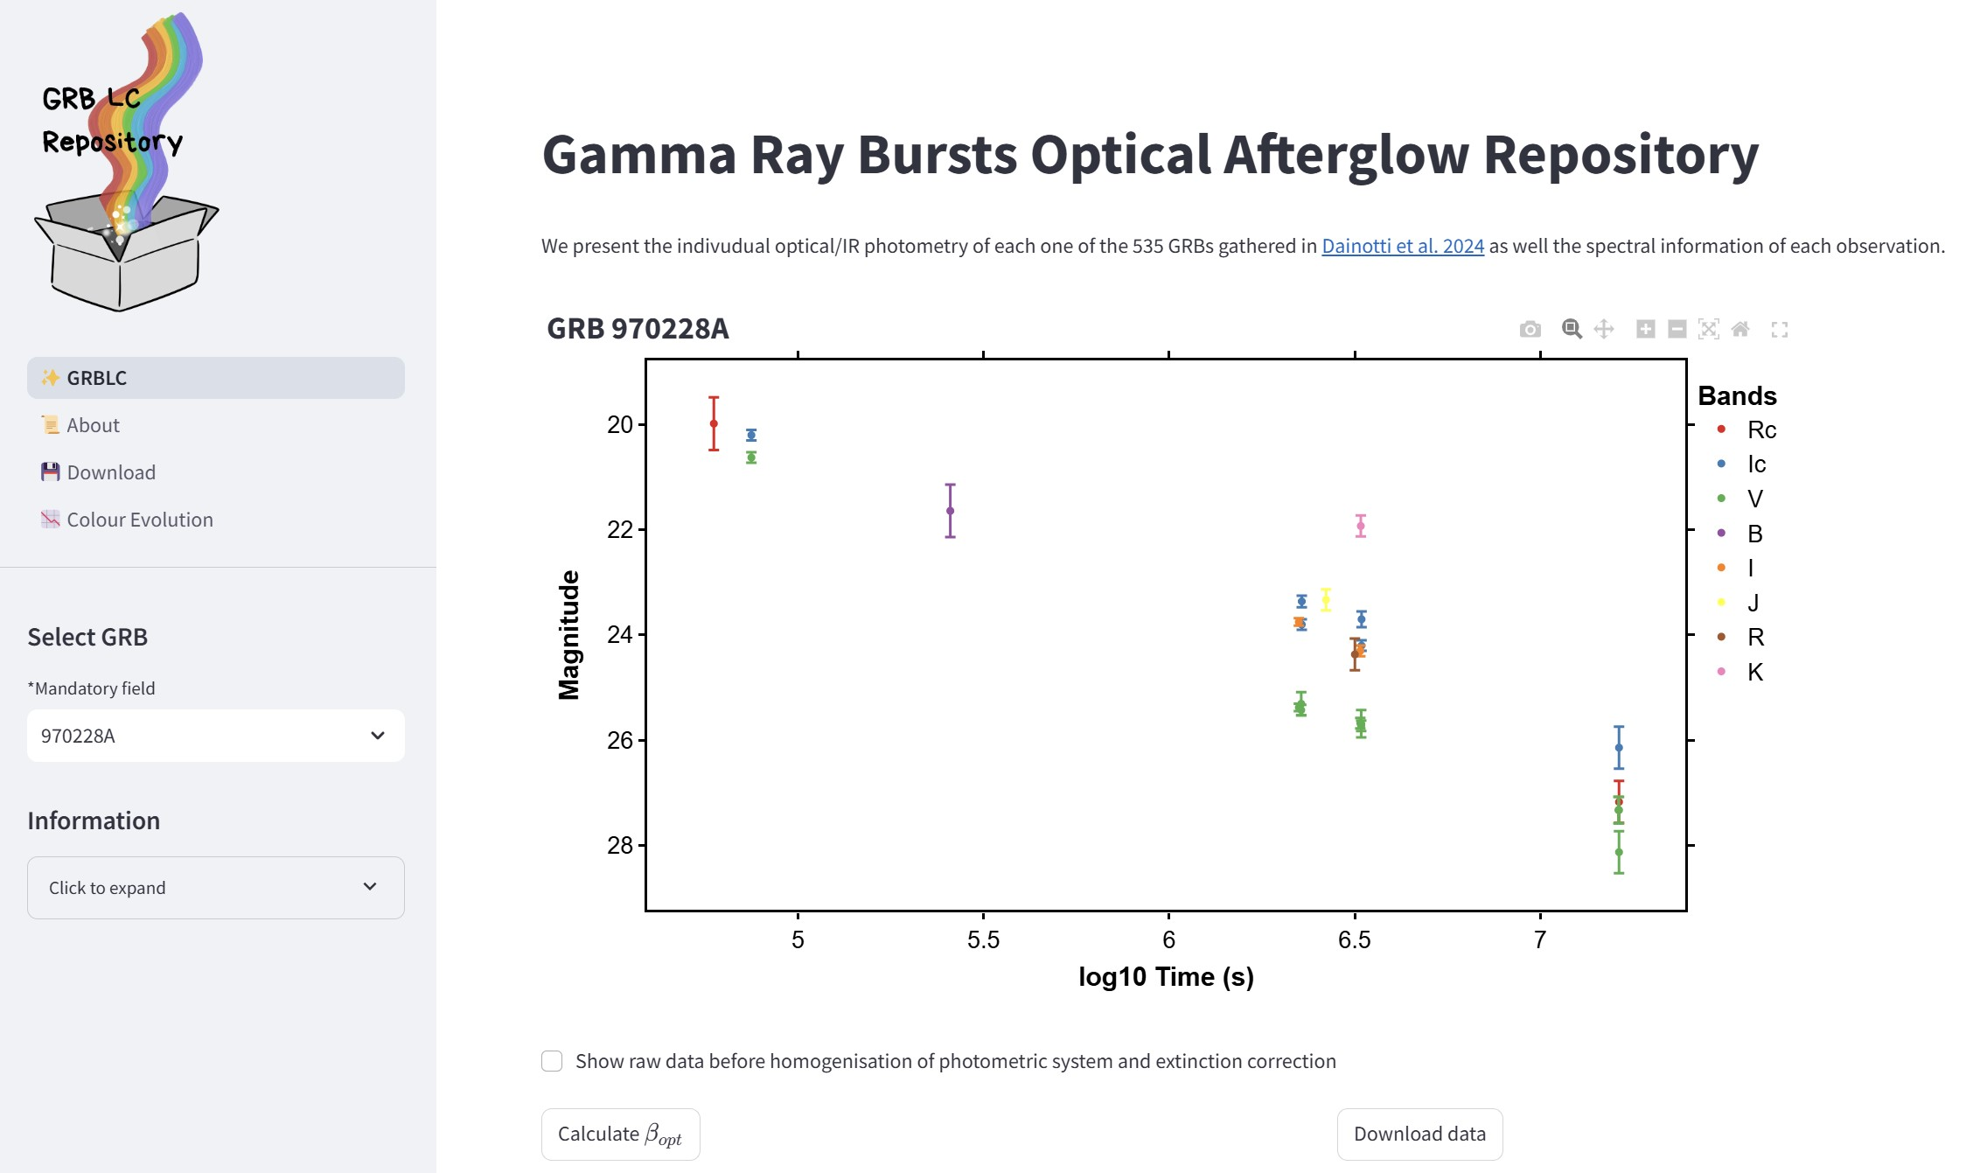
3
The largest GRB Optical Repository: GRB LC package affiliated with NAOJ
Dainotti et al., including Y. Niino, T. Moriya, ..., 2024, MNRAS, 2024, 533, 4023.
535 GRBs with redshift
Easily searchable
455 Telescopes
570 Instruments
Large to small apertures:
14 GRBs from Subaru,
1 from Kiso at z=3.6, and
other Japanese Telescopes.
Re-calibration
GRBs observed by Kiso (Dainotti, PI) since 2022.
Joint KISO and SVOM.
Product: accessible via
web-app
ERG, 2022, part II

Slide 13
Overview
WHAT ARE WE TRYING TO DO?
We are training a supervised machine learning model on optical photometric GRB properties to reliably predict the redshift.
Using this model, we will estimate the unknown redshift of GRBs.
6
WHY ARE WE DOING THIS?
Currently, the SWIFT GRB catalog only has 26% of GRBs (~400) with measured redshift.
Redshift measurements are crucial for the cosmological application of GRBs.
Thus, a larger sample of GRBs with redshift can help address many outstanding cosmological mysteries.
People have been trying for a GRB redshift estimator for 22 years with limited success
This highlights the difficulty of the problem and why we needed to mature the methodology before applying to GRBs
HOW ARE WE GOING DO IT?
We are applying the SuperLearner machine learning model to GRBs.
We use MICE to impute missing data
Use O2 predictors for analysis
Applying Optimal Transport Bias Correction
For the first time, using optical plateau properties for GRB redshift estimation.

Slide 14
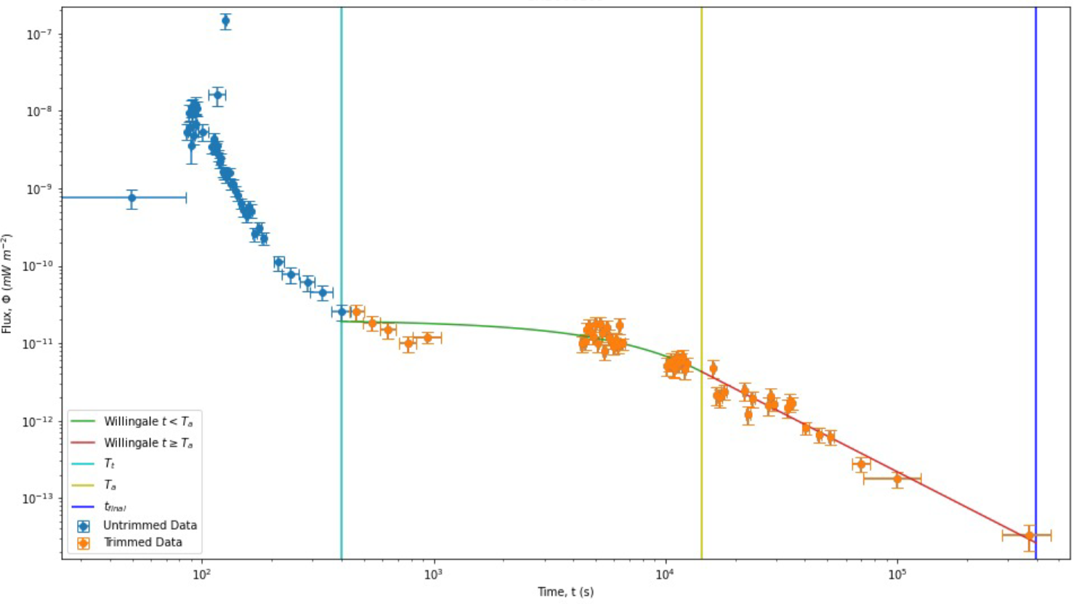
Data Sample
7
Dainotti, Narendra, Pollo et al. 2024, ApJL, 967L,30
We are using 179 GRBs which show the optical plateau in the lightcurve.
These are taken from “The Optical Two- and Three-dimensional Fundamental Plane Correlations for Nearly 180 Gamma-Ray Burst Afterglows with Swift/UVOT, RATIR, and the Subaru Telescope” (Dainotti et al. 2022d)
The dataset contains GRBs from Swift/UVOT, RATIR and the Subaru.
We use 9 features in this analysis:
4 features from the prompt emission:
Fluence,
T90,
Peak flux,
Photon Index
5 features from the plateau emission:
Time (Ta), Flux (Fa),
Temporal index (α), Spectral index (β) at the end of plateau &
Hydrogen column density (NH)

Slide 15
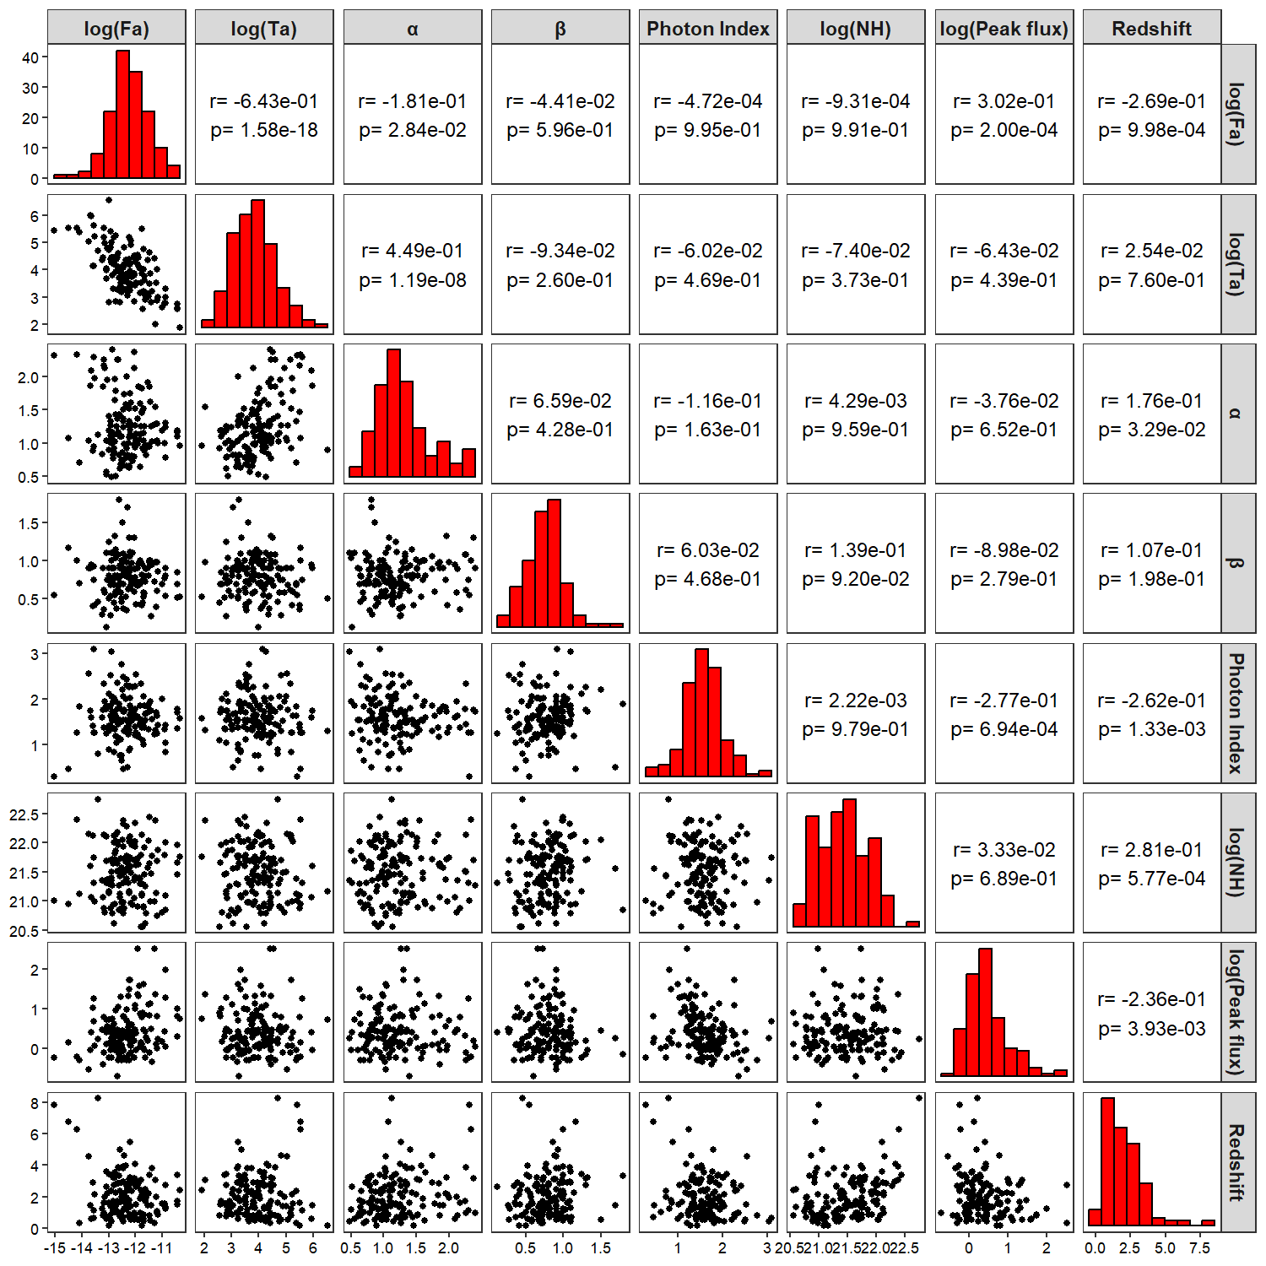
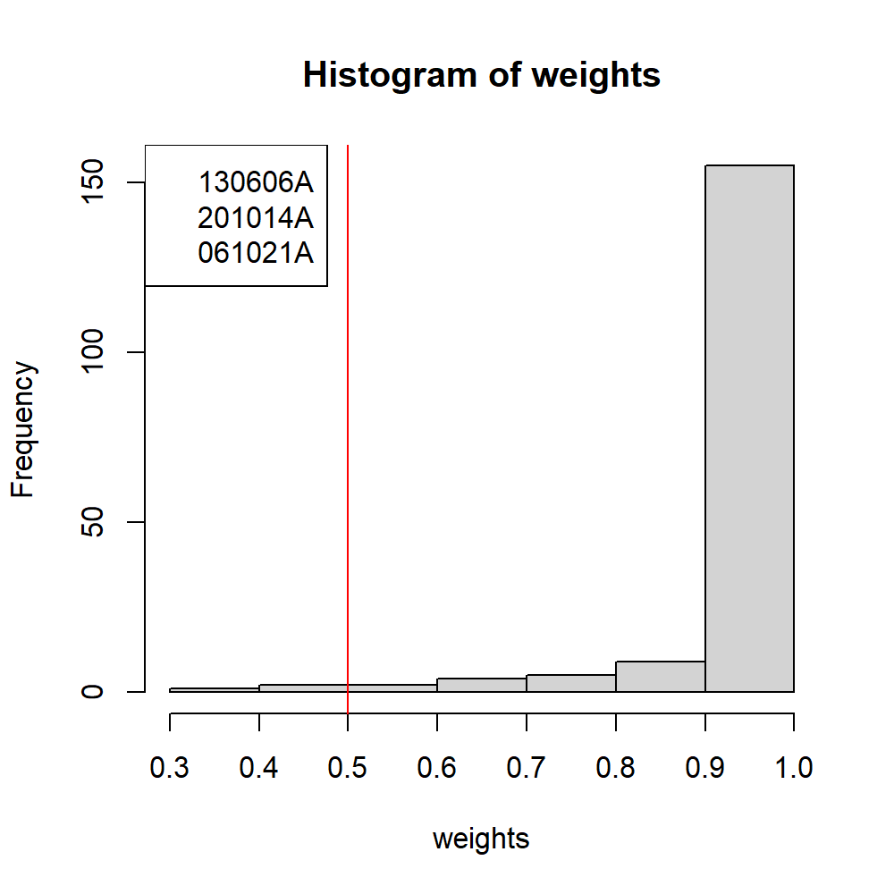
Data Sample: Outlier
8
Finally, we remove 3 GRBs as outliers using the Robust Linear Model with M-estimator, by selecting a cutoff weight of 0.5.
Training set= 176 GRBs

Slide 16
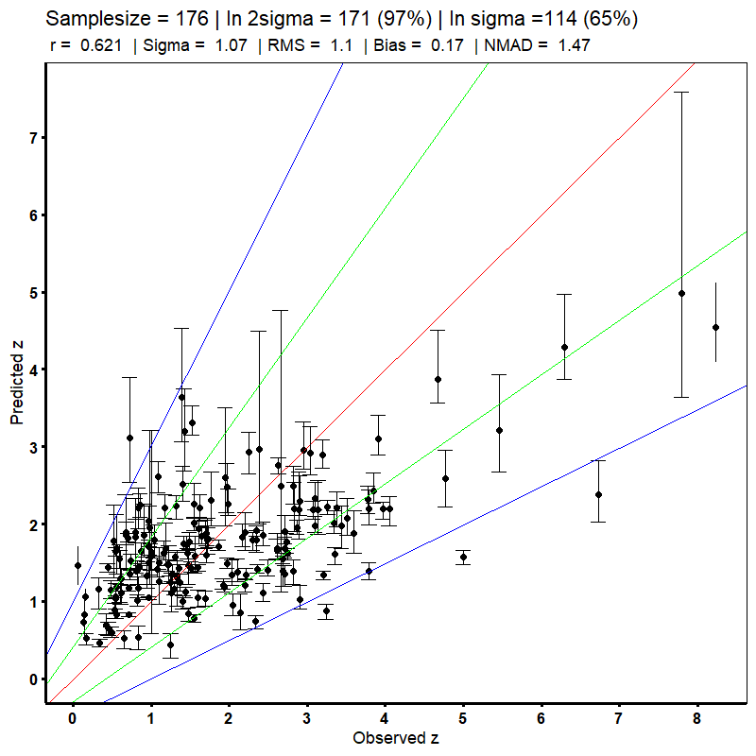
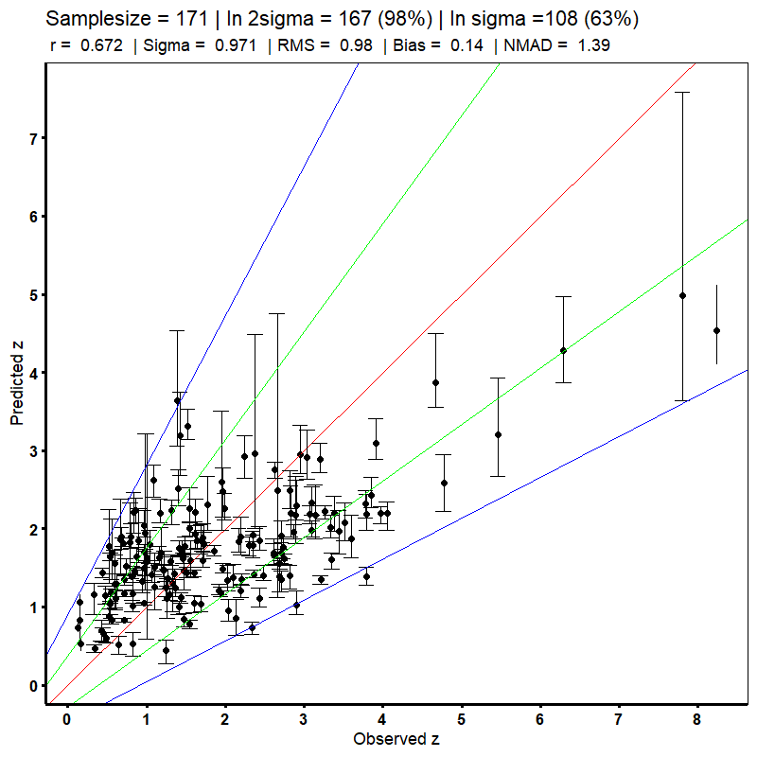
Results From Superlearner:
9
Remove outlier

Slide 17
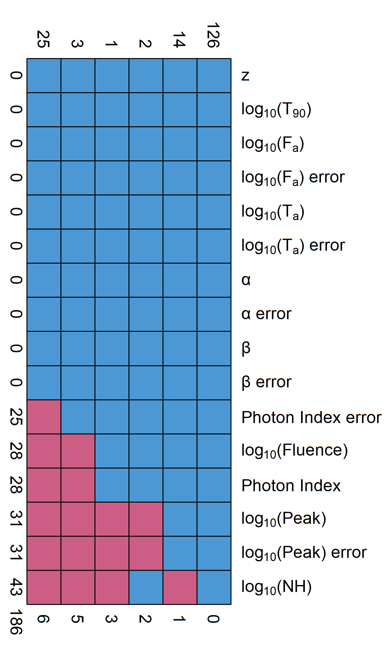
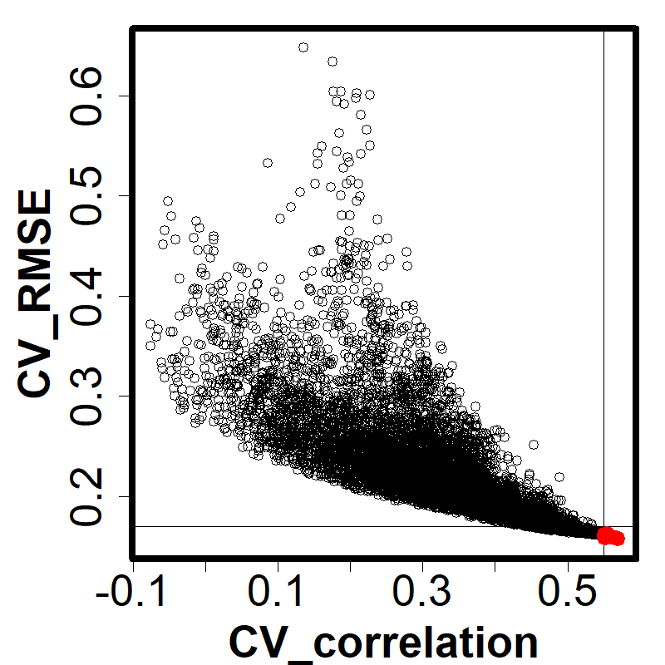
METHODOLOGY
10
MULTIVARIATE IMPUTATION BY CHAINED EQUATION (MICE)
26% of 171 (45 GRBs) have missing data.
This is a method used for imputing missing data.
MICE uses the data present to infer the missing data.
We use Predictive Mean Matching method for imputation.
Previous publications have demonstrated its effectiveness
FORMULA ESTIMATION
We combine 7 predictors to generate 16000+ formula
Select a subset of formulas based on cross-validated results
Further tested on a separate test set
Formula with best correlation, RMSE and MAD are picked.
Notes:
However, 26% of that 171 GRBs have missing data in them. So, we can either drop them, or use MICE to impute them.
MICE uses the data present to estimate what the missing values could be.
There is an assumption that the data is missing at random without any relation to eachother.
MICE supports multiple methods for imputation and the one used here is called predictive mean matching.
We have used this in our previous publications as well, and recently our very first publication using MICE won an Editor’s Choice Award for Astrostatistics from Frontiers Journal.
For the predicting the redshift we use polynomial functions created by combining the 7 predictors and their square terms. Over 16000+ formulas were tested for this.
Each of the formula’s score,based on RMSE and pearson Correlation is show in this figure. We select only a small subset that have low RMSE and high correlation.
This subset is further tested on a separate test set, and then finally we pick 3 formulas, which have the lowest RMSE & MAD and highest correlation.

Slide 18
Methodology
11
log(z+1) = (log(NH) + log(T90) + PhotonIndex + log(Fa))² + log(Ta) + α + β + log(Fluence) + log(Peakflux)
Generalized Linear Model (GLM)
Bayesian GLM
GAM
StepAIC
SuperLearner!
We did test many other ML models, but these 4 obtained the highest weights by SuperLearner consistently.
For GLM and bayes GLM to use the formula we had to develop custom functions in SuperLearner.
For the results we perform 10-fold cross validation 100 times and take their average.

Slide 19
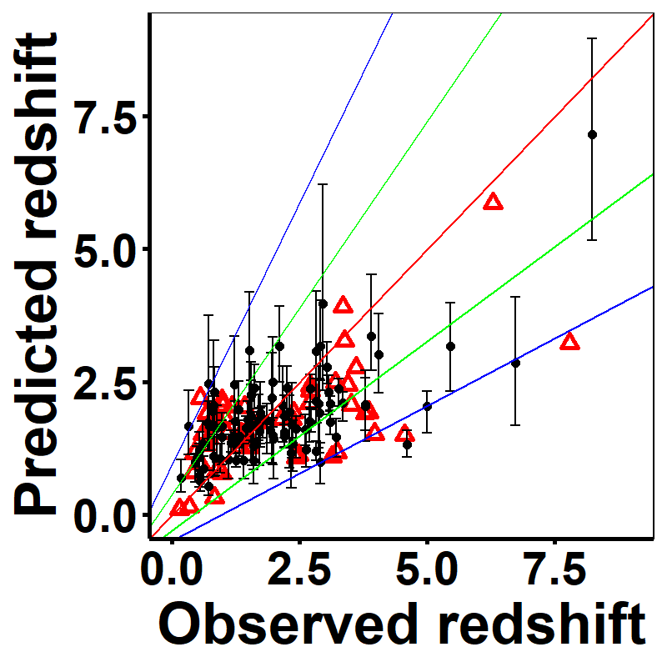
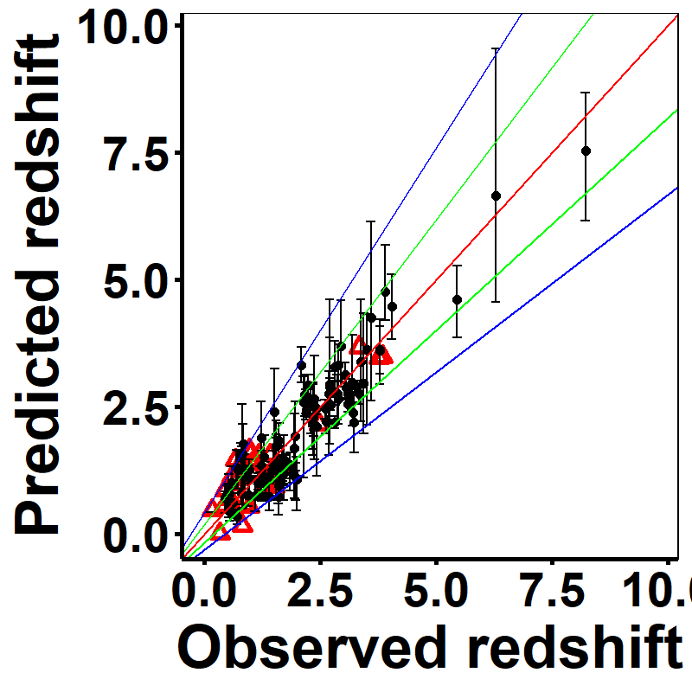
METHODOLOGY
12
SUPERLEARNER & ML MODELS USED
Supervised ML method
Ensemble method
We combine GAM, GLM, BGLM, StepAIC
Custom formula used for GAM, GLM & BGLM.
10 fold Cross-validation performed 100 times.
We remove the errorbars (red triangles) for the cases in which δzpred/zpred ≥ 1.
BIAS CORRECTION
Reduces biases in ML predictions
Optimal transport bias correction
Final results are presented following this application.
Notes:
Coming to the main ML method we use, called Superlearner. This is an ensemble method, meaning it can combine multiple ML models to generate a single more powerful model.
We combine 4 methods, namely Generalized Additive Model (GAM), Generalized Linear Model (GLM, Baysian Generalized Linear model (BGLM) and Step AIC.
Except stepAIC all three methods fit the formulas estimated in the previous step to the training data.
The results shown here are obtained from a 100 times 10-fold cross validation,
After obtaining the cross-validated results we apply the bias correction method called optimal transport.
You can see how Bias correction corrects the bias in our prediction.

Slide 20
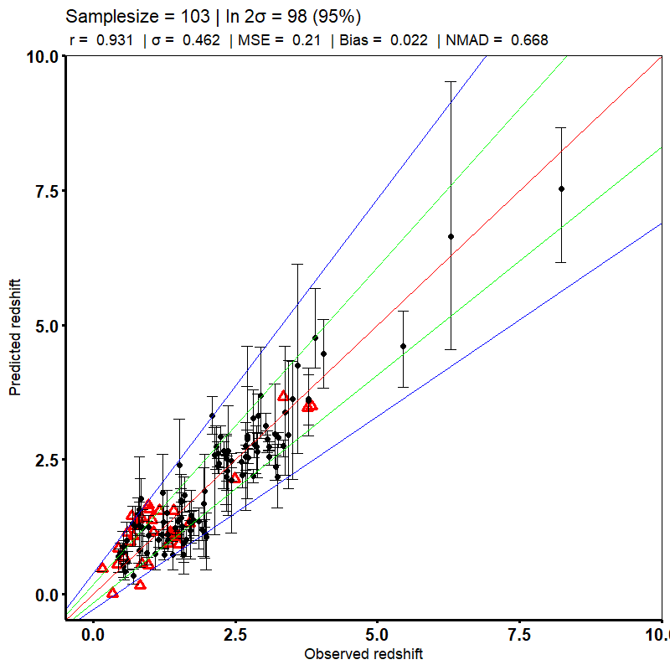
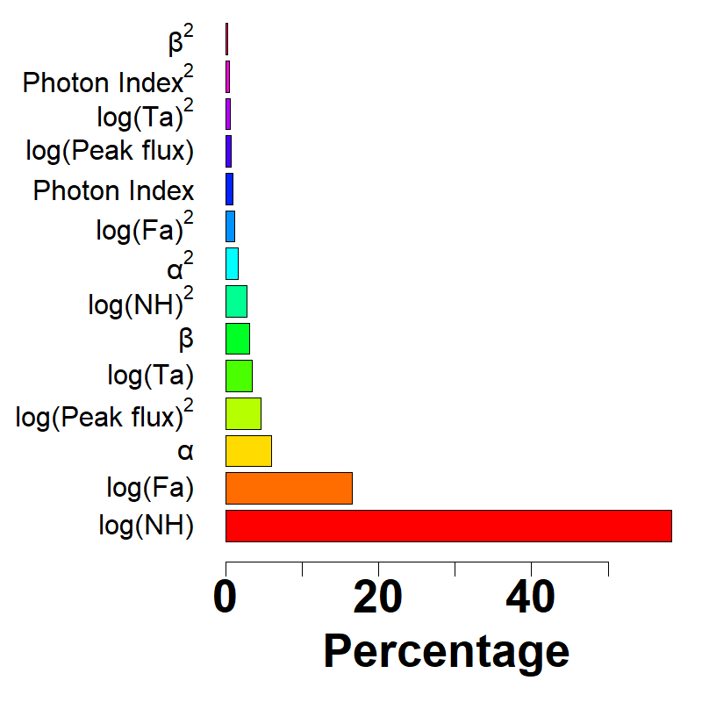
RESULTS
CV RESULTS
This is after bias correction+removing outliers
Pearson correlation 0.93
Mean square error 0.21
61% higher correlation than Ukwatta et. al 2016.
Less number of predictors (7 vs 11).
log(NH) and log(Fa) most important redshift predictors.
Two out of top 3 predictors are plateau.
103 GRBs used for LF & DRE
The optical sample
13
Notes:
Coming to the results, here is our cross-validation result. This is obtained after applying bias correction and removing catatrophic outliers.
We achieve a correlation of 0.93 btwn obz & predz and a mean squared error of 0.21
This result is 61% higher than that achieved by Ukwatta et al. 2016 and we achieve this with 7 predictors.
Coming to the importance plot, we can see that log(NH) and log(Fa) have the highest impact on the redshift estimation. Infact two of the top 3 are plateau features, which is a really promising and encouraging sign for plateau features and warrants further research.
The 103 GRBs shown here are selected for the next steps, which is trying to obtain cosmological parameters of GRBs using these CV redshift predicitions.

Slide 21
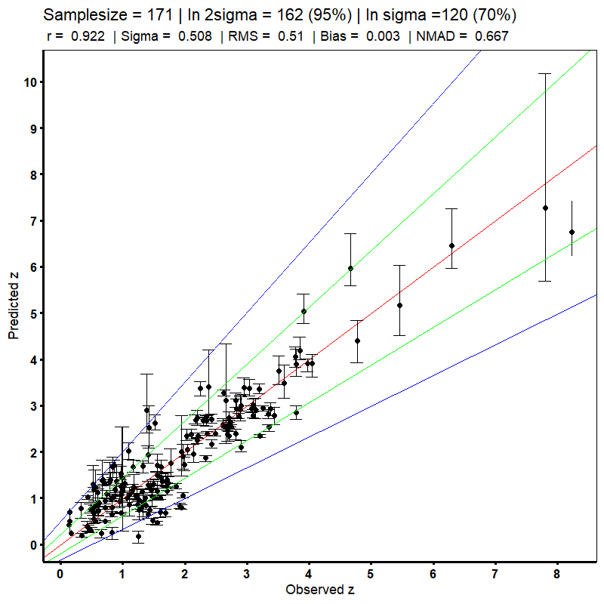
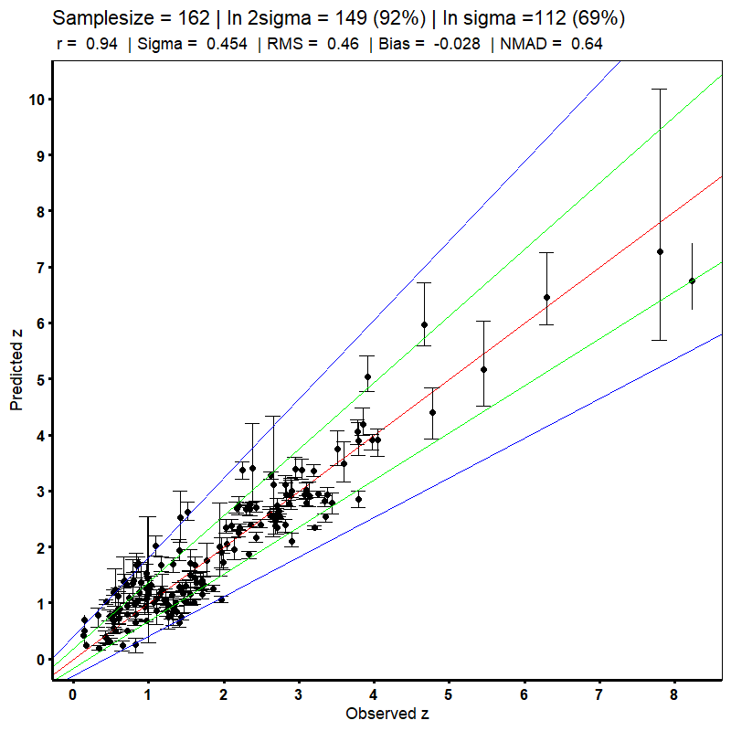
After Optimal Transport Bias Correction (the X-ray sample)→ Dainotti, … Pollo, 2024ApJS..271...22D
14
Remove outlier
162 GRBs:
Pearson correlation,
r=0.94
RMSE =
0.46
Bias =0.03
Comparing with Ukwatta et al. 2016,
we have 56% of the Pearson correlation

Slide 22
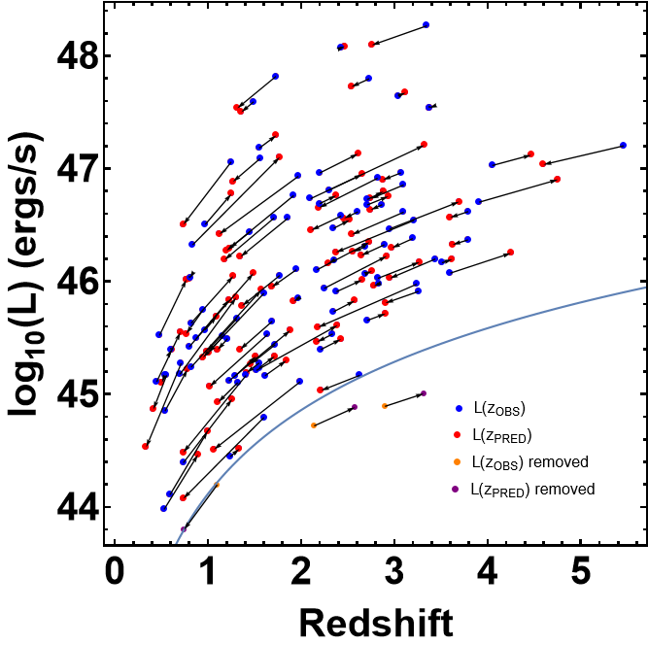
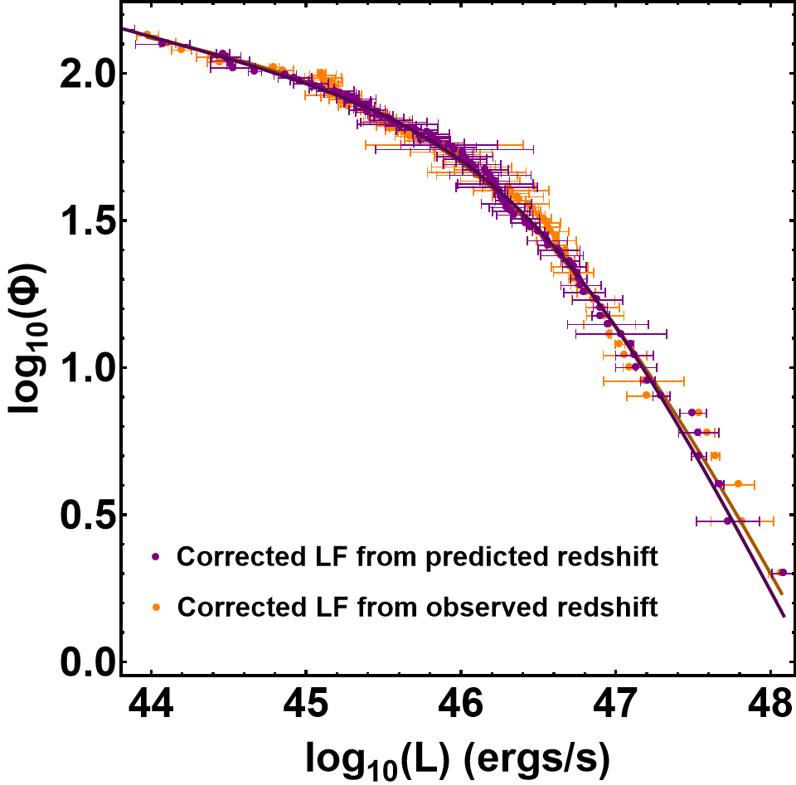
RESULTS
LUMINOSITY FUNCTION
Comparing LF derived from z_{obs} and z_{pred}
We trim 103 GRBs to 97
Flux limit 1.25x10⁻¹⁴ergs/cm²
Applied Efron & Petrosian method.
Smooth broken Powerlaw fitted.
L_{break} (Z_{obs}) = 46.6 +- 0.3
L_{break} (Z_{pred}) = 46.6 +- 0.11
Compatible in 1σ
15
Notes:
First we determined the luminosity function.
Here we derive the LF using both Zobs and Zpred
We trimmed 103 GRB to 97 based on a flux limit of 1.25x10^-14. You can see the L vs z plot.
The lines connecting the red and blue points show how the observed and predicted values for GRBs changes.
We applied the Efron Petrosian method for correcting for selection biases on these 97 GRBs and obtained the corrected LF.
After fitting a SBPL we observe that the Luminosity breaks obtained from Zobs and Zpred are both compatible within 1 sig. This is a promising result for future analysis.

Slide 23
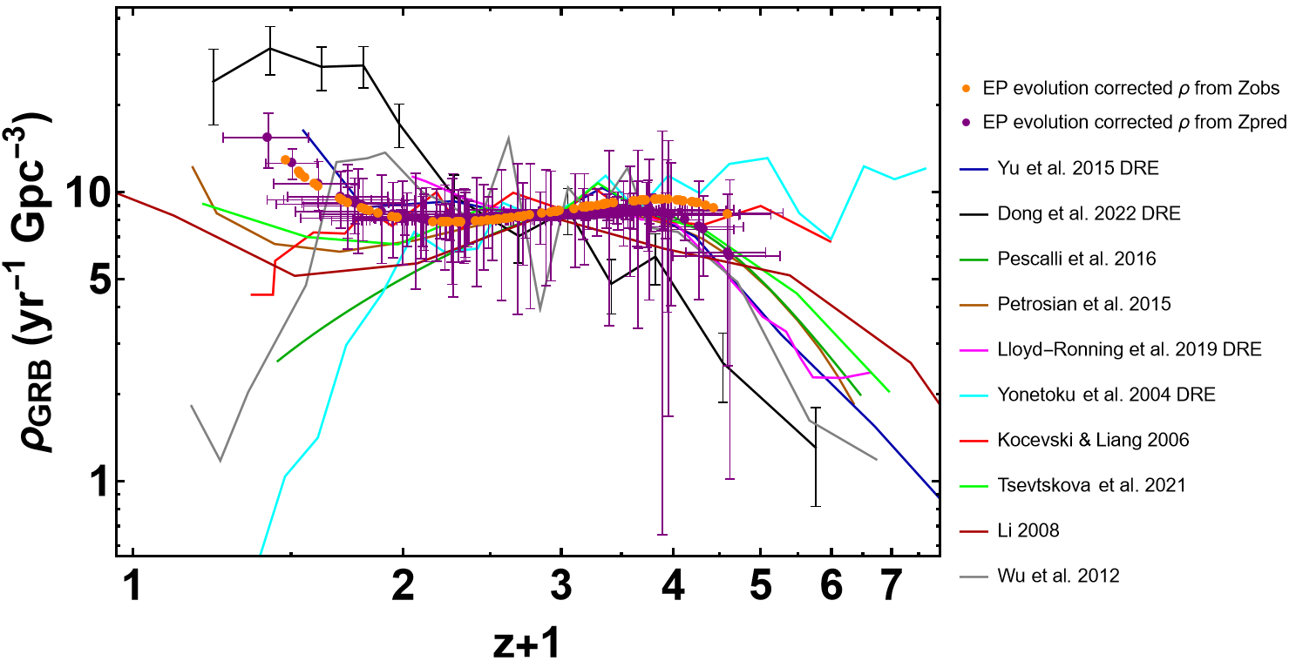
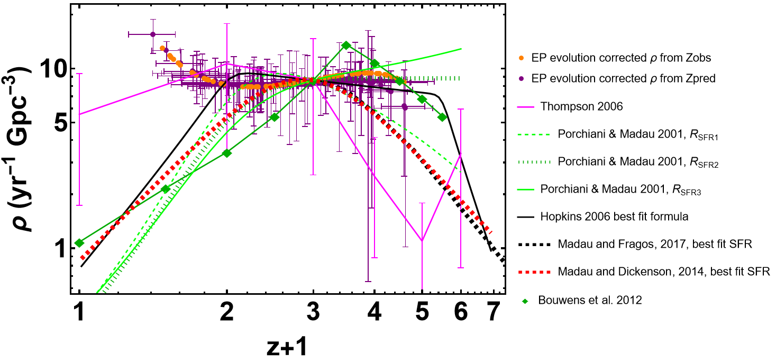
RESULTS
16
DENSITY RATE
The DRE plot z_{obs} and Z_{pred}
The actual rate, without arbitrary factors, accounting for FoV of Swift + number of observational years + downtime of Swift + fraction of GRBs with plateau.
the actual rate is 8.47 − 9 Gpc⁻³ yr⁻¹ for 0.9 < z < 2.3
Both DRE match other GRB DRE in literature
Discrepancy at low-z with SFR present here as well.
Notes:
Coming next to the LGRBs density rate, we similarly followed the EP prescription.
The orange dots show the corrected DR obtained from Zobs and the purple data points show the corrected DR obtained from Zpred.
One important point to note here is that DR we obtain here is without any arbitrary factors or normalization.
We have taken into account many different factor such as field of view of swift, number of observational years, etc.
And what we find is that the actual rate to be around 8.47 – 9 GPC/YR between redshifts 1.9 and 2.3.
We have compared our result with other GRB DRs in the literature as you can see in the upper plot. It should be noted that our DR is compatible with majority of the DRs.
We also compare our DR with the SFR history in the plot below and as it can be clearly seen, the discrepancy btwn SFR & GRB is present in our results as well.

Slide 24
CONCLUSIONS
17
Using plateau features for GRB redshift prediction is effective.
Can be used for predicting unknown-z 😉
The LF from z_{obs} and z_{pred} are compatible in 1σ!
LGRB DRE discrepancy with SFR at low-z
THESE PREDICTIONS CAN BE USED FOR DERIVING the rates: 11 Gpc⁻³yr⁻¹ at z<1. One order of magnitude higher than the predicted values
Notes:
Coming to the conclusion, here are the 4 main points.
Most importantly, we have achieved what we set out to do, as stated in the first slide. And that is we have successfully trained a ML model that can be used for obtaining reliable redshift predictions of LGRBs and these can be used for deriving important astrophysical properties of LGRBs. To the best of our knowledge this is the first work of it kind and now the doors are open for further research and interesting results

Slide 25
Explanation for the excess at low-z
18
Low-z GRBs have the same progenitors which are binary NS mergers, see Petrosian & Dainotti 2024, ApJ, 963L,12P. Observational instances are GRB 211211A and GRB 230307A: long GRBs associated with Kilonovae.
Following Yoon et al. (2006), the excess is related to the increase in metallicity with cosmic time, which prevents a larger fraction of massive stars from producing GRBs.
Low luminosity GRBs follow the LF, so the answer cannot be on those for the excess.

Slide 26
The generalization and the training set
19
Based on the X-ray redshift sample
Dainotti, … Pollo et al. 2024, ApJS, 271, 1, id.22.
Distributions of logTa and log NH are different between the training set and the generalization set

Slide 27
The relative influence
20
The Dainotti 3D plane is naturally recovered

Slide 28
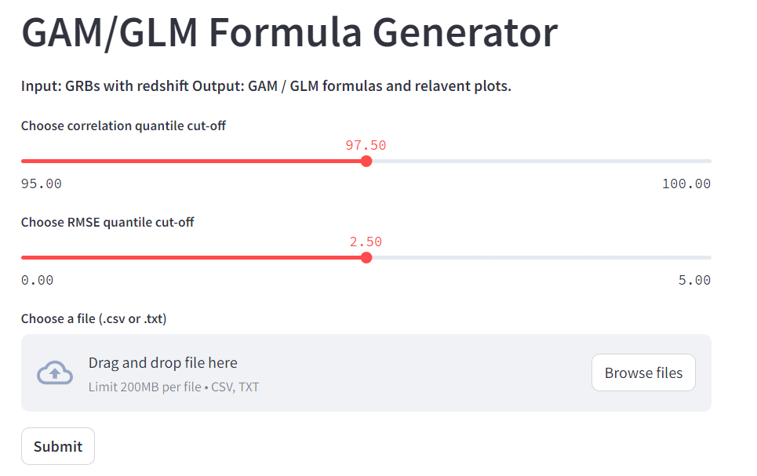
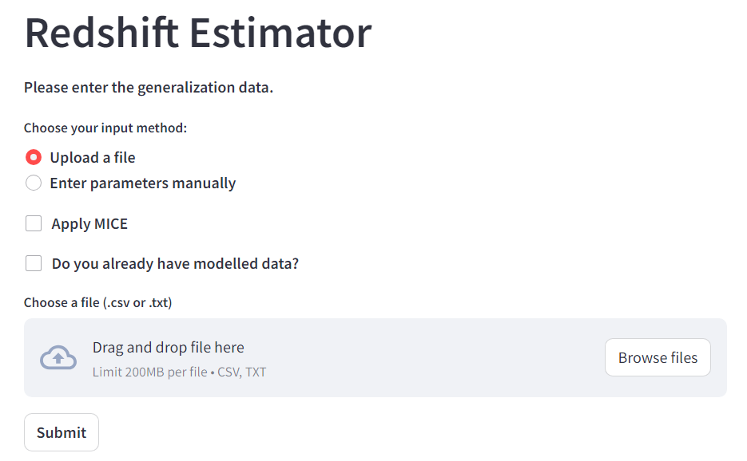
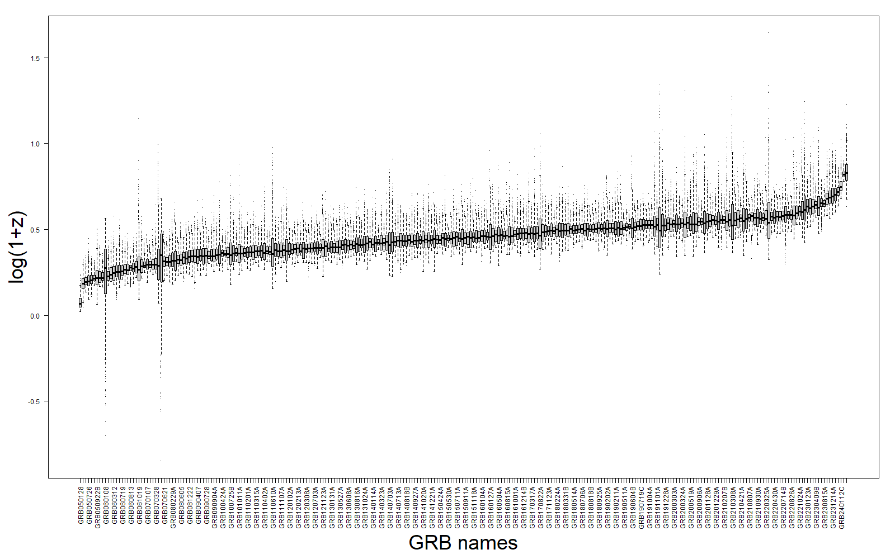
current work
a webapp
Expanded methodology with more data
Applying to GRBs without redshift
Narendra, Dainotti, .. Pollo et al. A&A, 2025A&A...698A..92N
21

Slide 29
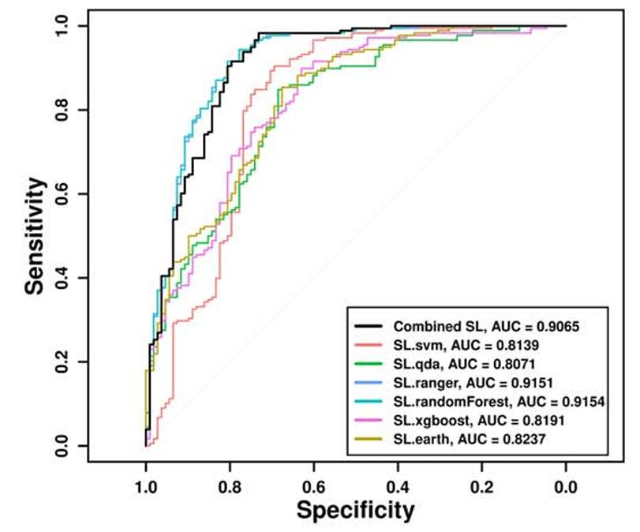
Superlearner applied for Classification
22
The Astrophysical Journal Supplement Series, Volume 277, Issue 1, id.31, 34.
Sensitivity = TP /(TP+FN)
A sensitivity of 87% and 89% with a balanced sampling for both z_{t} = 3.0 and z_{t} = 3.5, respectively→
9% and 11% increase in the sensitivity over random forest used alone.

Slide 30
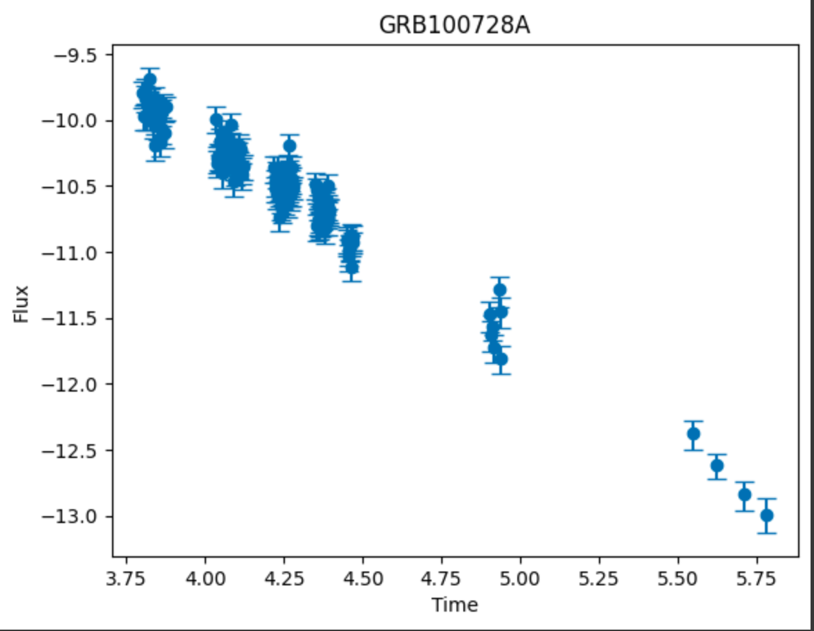
Gamma-Ray Burst Light Curve Reconstruction: A Comparative Machine and Deep Learning Analysis (ApJS accepted, Machanda, Gupta, Dainotti, Suzanna, et al.)
Aim:
To reconstruct the gaps in the Light Curve using ML/ Statistical models.
Decreasing the uncertainty associated with the W07 parameters.
We have used 9 models to reconstruct the LCs: MLP, Bi-MAMBA, GP-RF, Bi-LSTM, CGAN, KAN, Attention UNet, Fourier transform and Sarimax based Kalman filter model.
Data:
Dataset comprises of 545 GRBs, originating from the Swift BAT-XRT repository. The GRB’s have been classified into four distinct classes based on the features of their afterglow emission: Good, Break, Flares/Bumps, Flares/Bumps + Double Break
GRB Light curve
Temporal gaps defined as greater than 0.03 in the time scale.

Slide 31
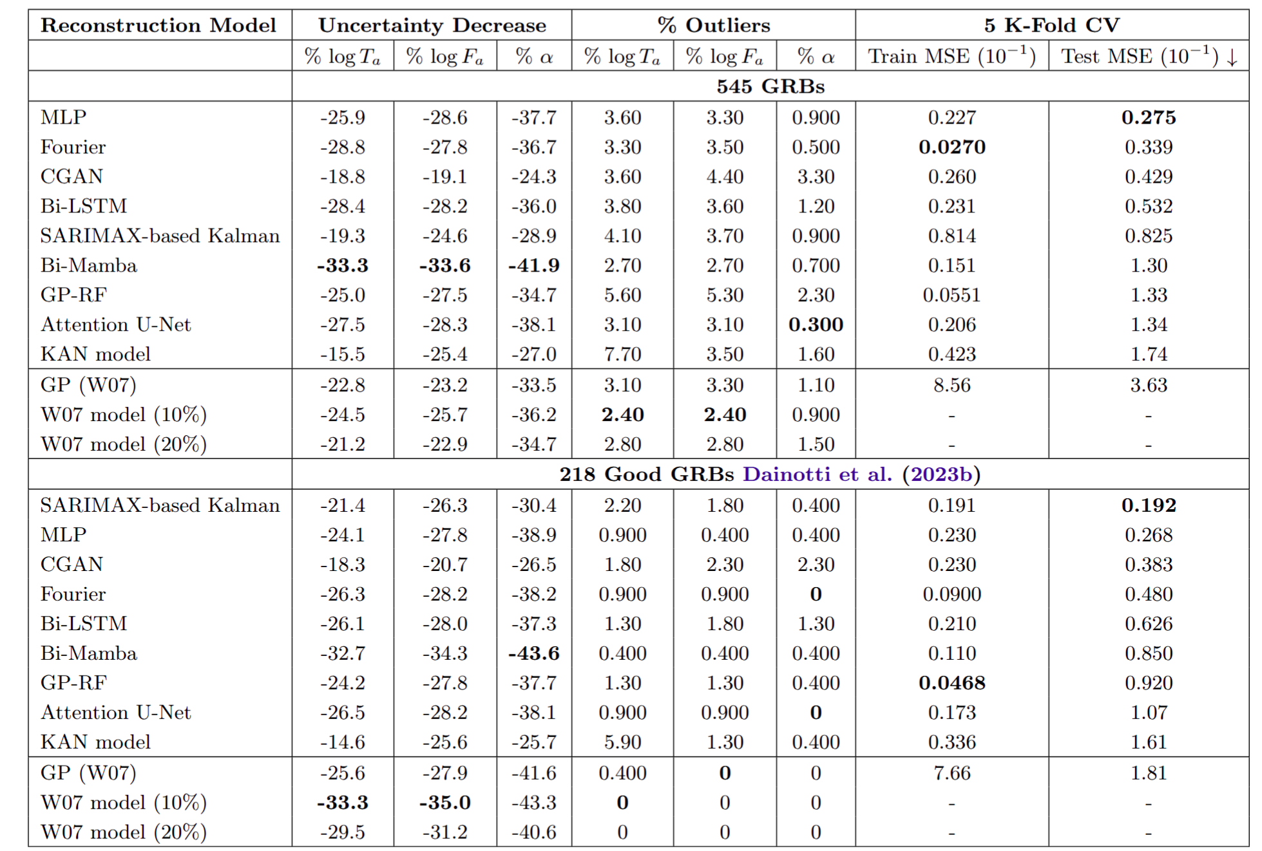
Gamma-Ray Burst Light Curve Reconstruction Results
The Bi-Mamba model achieves highest uncertainty reduction across all parameters (33.3% for log Ta, 33.6% for log Fa, and 41.9% for α).
The MLP model provides the lowest 5-Fold Test MSE of 0.0275 among deep learning models, making it the best option when prioritizing reconstruction accuracy.
On comparison with Dainotti et al. (2023b): Bi-MAMBA slightly outperforms W07, achieving a 43.6% reduction in uncertainty compared to 43.3% with W07, indicating a difference of 0.7% but a noteworthy improvement. Compared to the GP model, Bi-MAMBA outperforms for all three parameters.

Slide 32
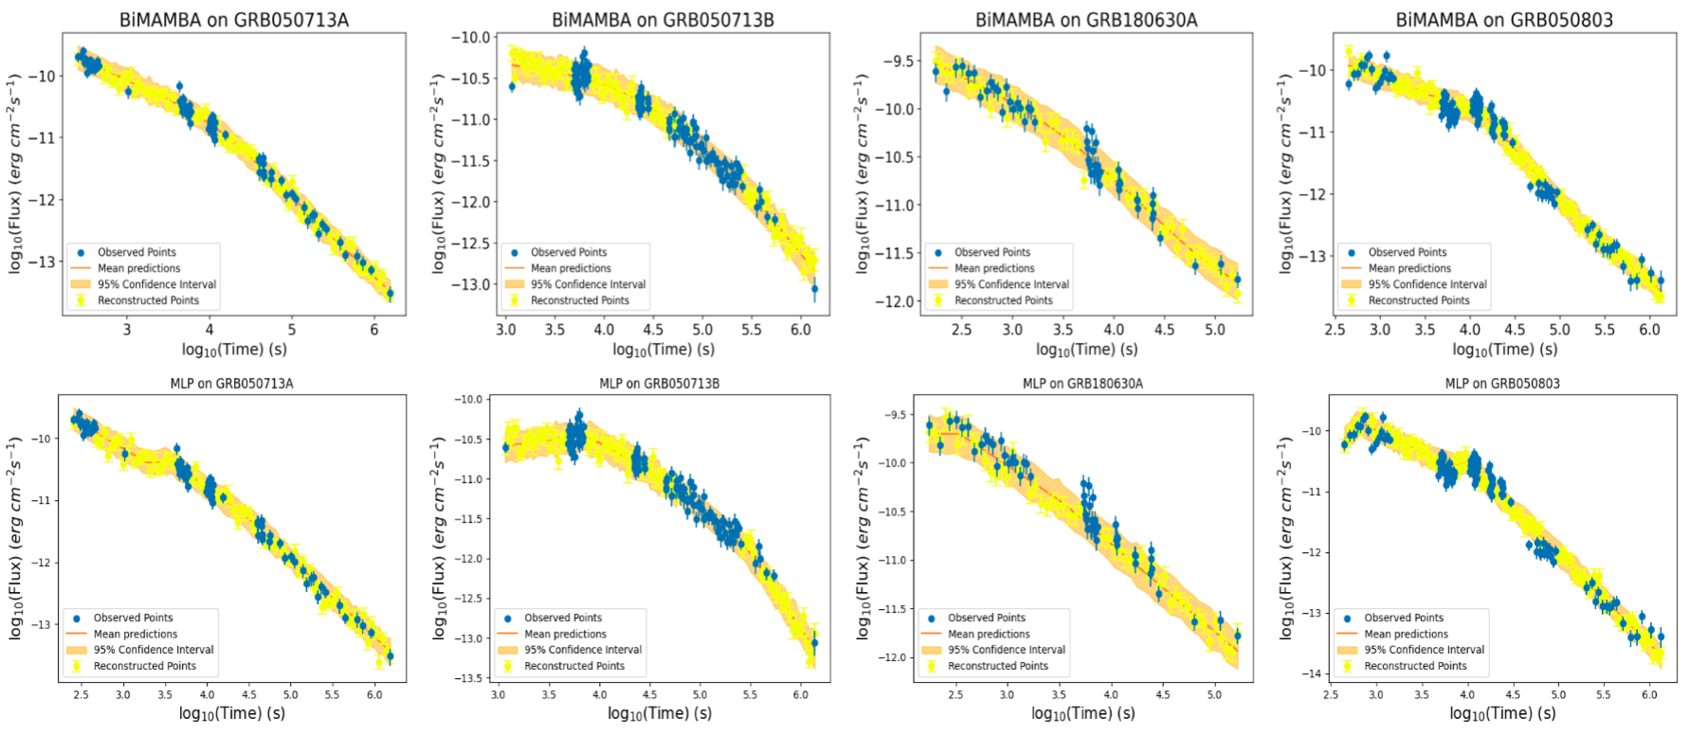
Results: MLP Multilayer Perceptron Model AND Bi-MAMBA (bi-directional Mamba)

Slide 33
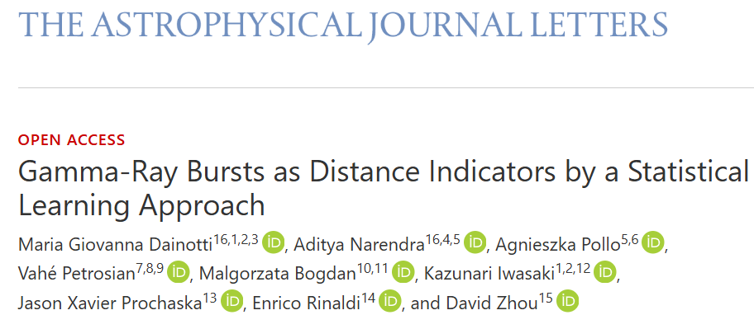
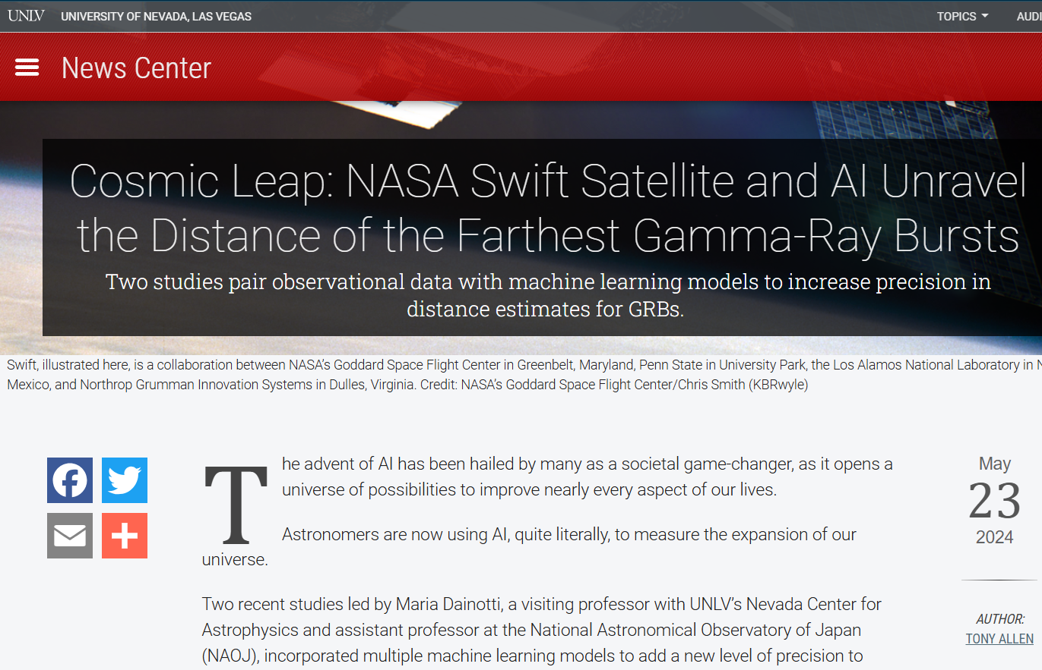
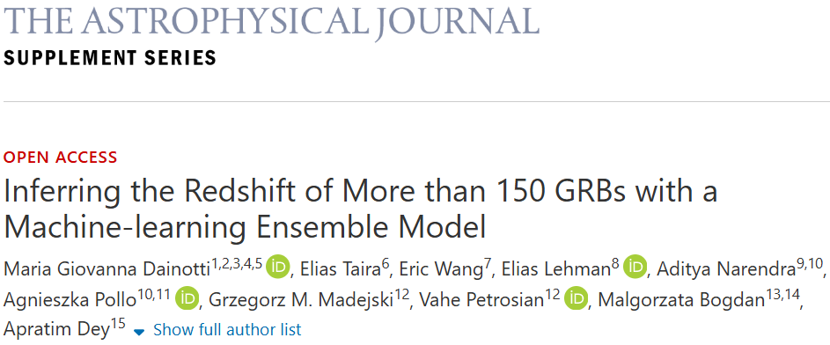
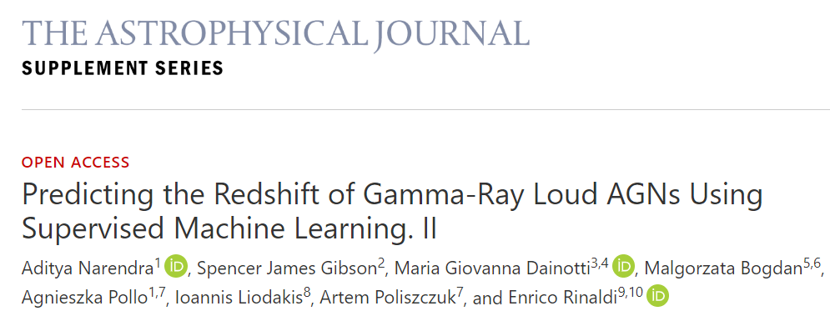
Thank you!
28

Slide 34
Back up slides

Slide 35
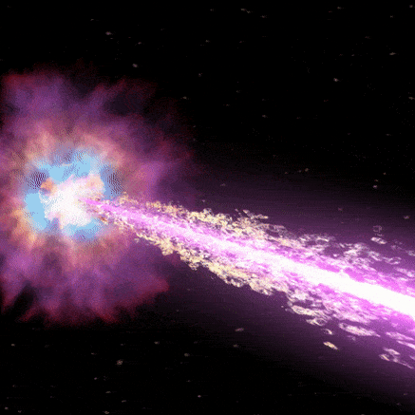
>>>>
More energy in few seconds than
our Sun makes in 10 billion years!
Notes:
Infact, GRBs are so incredibly powerful that they release more energy in a few seconds than our entire sun makes in 10 billion years!

Slide 36
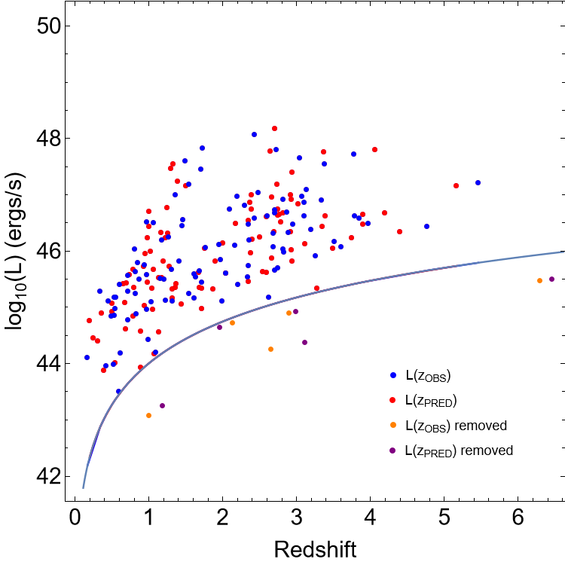
Density rate evolution and luminosity function:
For the density rate and luminosity analysis, we selected only the GRBs within the 1σ lines (greens).
Then we only kept the LGRBs, and a flux limited sample. The final analysis is done using 100 GRBs.
The aim is to show that the DRE and LF derived from observed redshift (Zobs) and predicted redshift (Zpred) are compatible with eachother!
Accounting of selection bias: Efron Petrosian Method

Slide 37
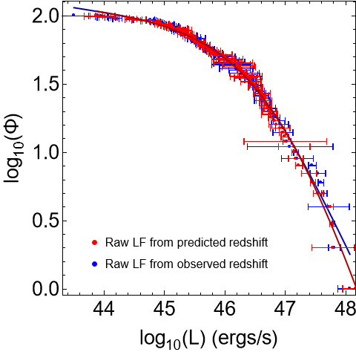
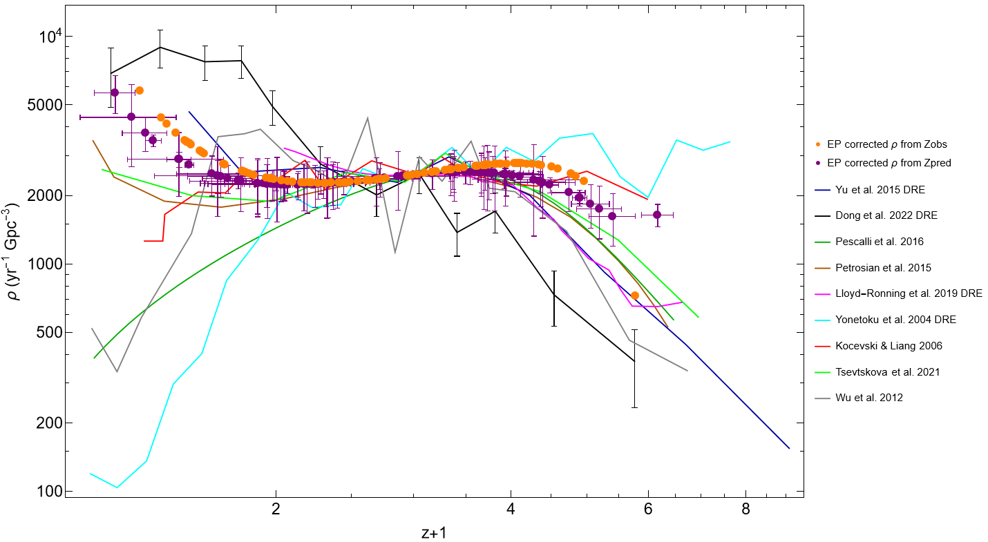
Density rate evolution and luminosity function:
The orange and purple show the selection bias corrected density rate evolution for Zobs and Zpred respectively.
The luminosity breaks for raw Zobs LF is 46.47+-0.16, and for raw Zpred LF is 47.05+-0.35 for smooth broken powerlaw fit
These are compatible within 1σ!
The blue points in represent the LF and DRE derived using Zobs.
The red points in represent the LF and DRE derived using Zpred.

Slide 38
Current And Up-coming Work:
Current work:-
Finalize the LF and DRE curves
Finalize the comparisions with the literature.
Upcoming work:-
Increasing the size of the training sample
Predicting the unknown redshift of GRBs
Integrating the ML model functionality into a website
Making the codes and methodology publicly available
GRB redshift classification & properties classification

Slide 39
LC Reconstruction – Results for BPL reconstruction
Table here showing error fractions before and after reconstruction, for 10% noise level. Last four columns show the relative percentage decrease in the BPL parameter error fractions. Similar to the W07 reconstruction, a majority of them show a decrease.

Slide 40
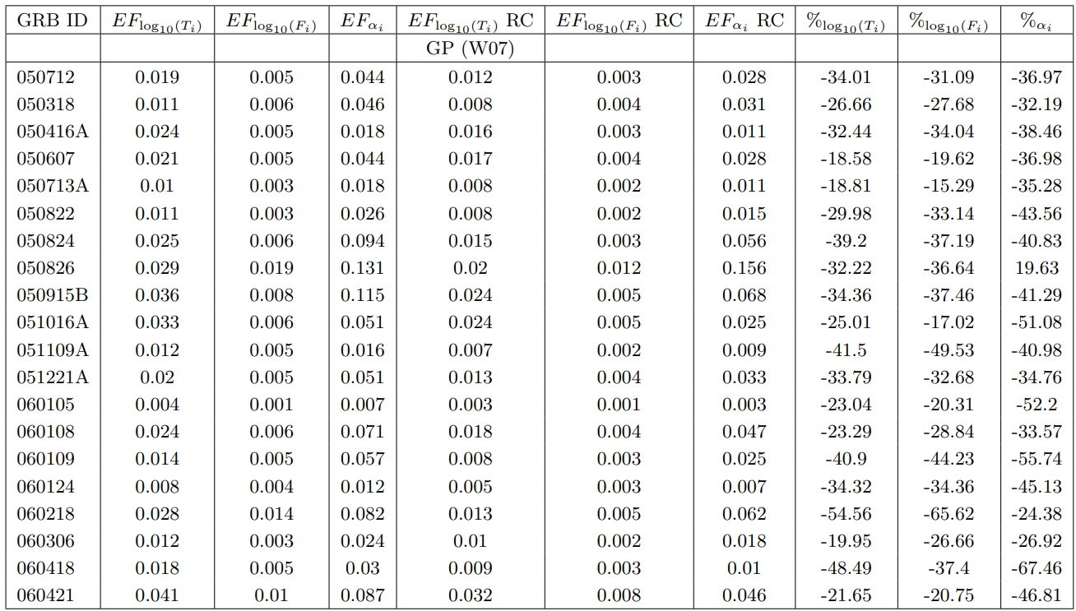
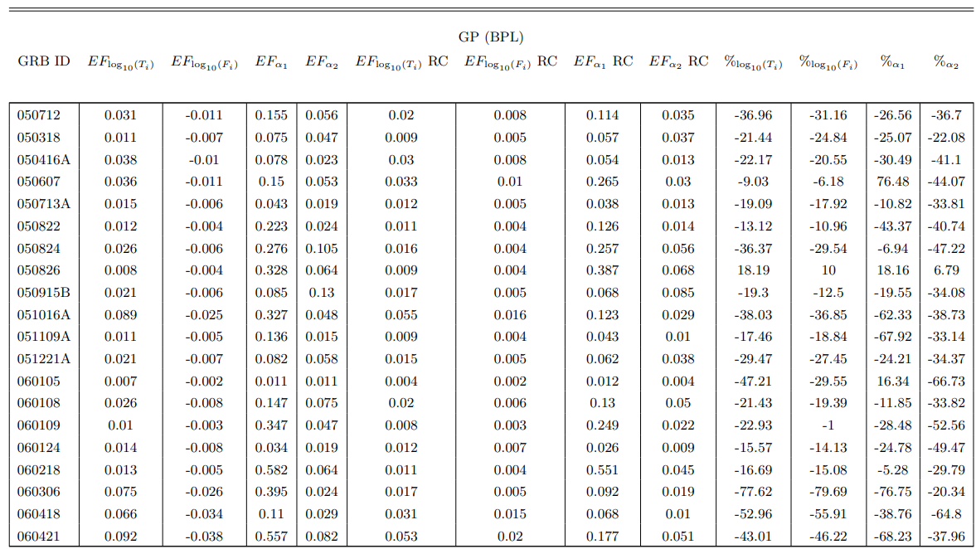
LC Reconstruction – Results for GP Reconstruction
Here we show the results from the GP reconstructed LC refitted with W07 and BPL.
We see a decrease in the error fractions here as well.

Slide 41
LC Reconstruction – Results for W07 reconstruction
Table showing error fractions before and after reconstruction.
Last three columns show the relative percentage decrease in the W07 parameter error fractions. As we can see, a majority of them show a decrease.

Slide 42
LC Reconstruction - Methodology

Slide 43
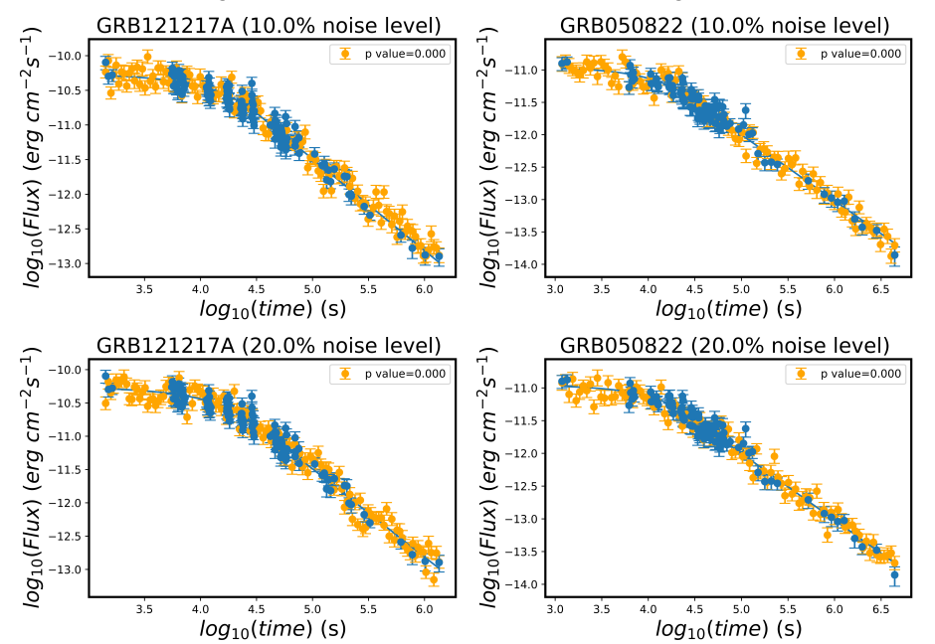
n = noise parameter (0.1, 0.2 and so on)
Adding noise:

Slide 44
How many redshifts we will predict
11

Slide 45
Methodology
14
An analytical formula using the 9 GRB properties
Combine 9 features to give good estimate for log(z+1)
Formula generator (over 16,000!!!)
Tested Generalized Additive Model (GAM) and picked the best fitting formula
For this we used the NAOJ Supercomputer facilities.
log(z+1) = (log(NH) + log(T90) + PhotonIndex + log(Fa))² + log(Ta) + α + β + log(Fluence) + log(Peakflux)

Slide 46
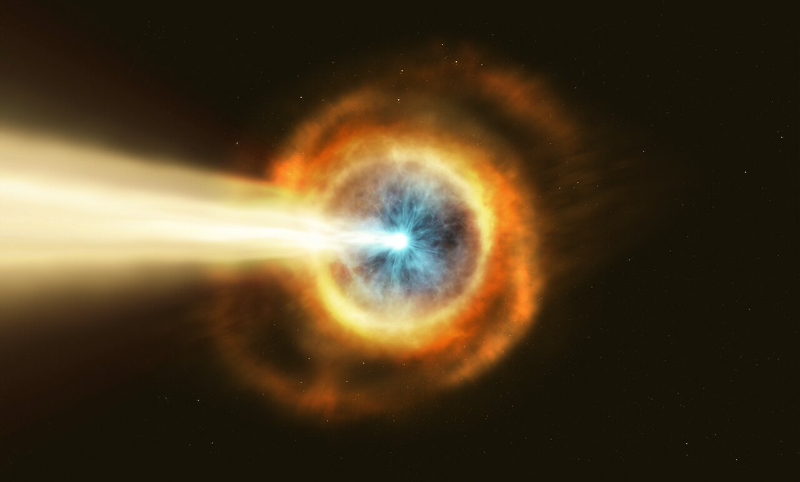
Introduction to GRB
Flashes of high energy photons in the sky (typical duration is few seconds)
The greatest amount of energy released in a short time, not considering Big Bang
Cosmological origin. Furthest GRBs observed z ~ 9.4
X-rays, optical, and radio radiation observed after days/months (afterglows), distinct from the main γ-ray events (the prompt emission).
Observed spectrum non-thermal.
GRBs are important for their energy emission mechanisms.

Slide 47
3
Why are GRBs potential cosmological tools?
Because They…
Can be probes of the early evolution of the Universe.
Are observed beyond the epoch of reionization.
Allow us to investigate Pop III stars.
Allow us to track the star formation.
Are much more distant than Supernovae (SNe) Ia (z=2.9) and quasars (z=7.54).
But They…
Don’t seem to be standard candles with their isotropic prompt luminosities spanning over 8 order of magnitudes (we need standard candles!)

